Slide 1
Module 2B Using PiT Counts to review and strengthen community data
Infrastructure Canada June 2024

Slide 2
Community Data: Person Specific Data, Unique Identifier List, and the PiT Count
Total homelessness
Person-Specific Data
Unique Identifier List
All those who have had system interactions
Consent to be part of housing process
PiT Count
Can be filtered to look at specific sub-groups
Active Homelessness
Actionable data to support housing

Slide 3
Leveraging the PiT Count to improve your community data
Options*
Conduct a joint PiT Count and Connection/Action Sprint (formerly Registry Week)
Leverage the PiT count as outreach for inclusion in community data
Compare your community data to your PiT enumeration
Compare demographic information from each data source
*These are not mutually exclusive

Slide 4
Options*
Conduct a joint PiT Count and Connection/Action Sprint (formerly Registry Week)
Leverage the PiT count as outreach for inclusion in community data
Compare your community data to your PiT enumeration
Compare demographic information from each data source
*These are not mutually exclusive
Building up your data
Assessing your coverage

Slide 5
Option 1: Joint PiT Count and Connection/Action Sprint
Leverage the organization of the PiT Count to launch a list using a Connection/Action event.
In addition to the anonymous survey, teams ask for consent to be added to HIFIS/HMIS data. Consent should be separate from the PiT Count to preserve anonymity for those who do not want to be identified. But, consent can include the ability to include information from the PIT survey.
If you don't have access to a community wide HMIS yet (but are expecting it soon), you can ask for consent to take personal information and check for inclusion in HIFIS/HMIS data after the count. Make sure you have the authority to collect identifying information.
Best suited for: Communities that are not (yet) using an HMIS for Coordinated Access

Slide 6
Option 2: PiT Count as outreach for inclusion in community data
Use the PiT count survey as an outreach activity to connect with those who are not yet in community data.
Similar to the Connection/Action event, this would involve a separate consent process after the anonymous survey. Some options:
Have a survey team member equipped with a tablet to confirm registration to the list, or
Ask respondents whether they’ve been added to the list and provide information about intake
Best suited for: Communities that are seeking to improve community data coverage, particularly among people in unsheltered areas.

Slide 7
Option 3: Compare a snapshot of your community data to your PiT enumeration
Compare your PiT enumeration from each location type to the number of people in your system data.
Limit your data to those experiencing homelessness on the enumeration night. Compare how many people in each shelter, encampment, etc.
Identify what is not in your List by design (e.g. Domestic Violence shelters) vs. real gaps (e.g. underserved unsheltered areas)
Best suited for: Communities that have an established list and are looking to identify or address gaps in coverage.

Slide 8
Option 3: Compare your community data to your PiT enumeration
PiT Data |  |  | List Data
Location | Count |  | Location | Count
Shelter | 120 |  | Shelter | 90
 |  |  | Emergency Shelter 2 | 25
 |  |  | Cold weather response | 20
 |  |  | Hotel Shelter Program | 15
Transitional Housing | 15 |  | Transitional Housing | 15
 | 5
Unsheltered Areas | 40 |  | Unsheltered Areas | 25
 |  |  | Hidden Homelessness | 20
Total | 185 |  | Total | 150
Notes:
PiT includes standardized questions that are asked to each respondent.

Slide 9
Option 3: Compare your community data to your PiT enumeration
PiT Data |  |  | HIFIS/HMIS Data
Location | Count |  | Location | Count
Emergency Shelter 1 | 30 | = | Emergency Shelter 1 | 30
Emergency Shelter 2 | 25 | = | Emergency Shelter 2 | 25
Emergency Shelter 3 | 15
Cold weather response | 20 | = | Cold weather response | 20
Hotel Shelter Program | 15 | = | Hotel Shelter Program | 15
Domestic Violence Shelters | 15
Transitional Housing 1 | 10 | = | Transitional Housing 1 | 10
Transitional Housing 2 | 5 | = | Transitional Housing 2 | 5
Unsheltered | 15 | < | Unsheltered | 20
Encampments | 25 | > | Encampments | 5
 |  |  | Hidden Homelessness | 20
Total | 185 | > | Total | 150
Notes:
PiT includes standardized questions that are asked to each respondent.

Slide 10
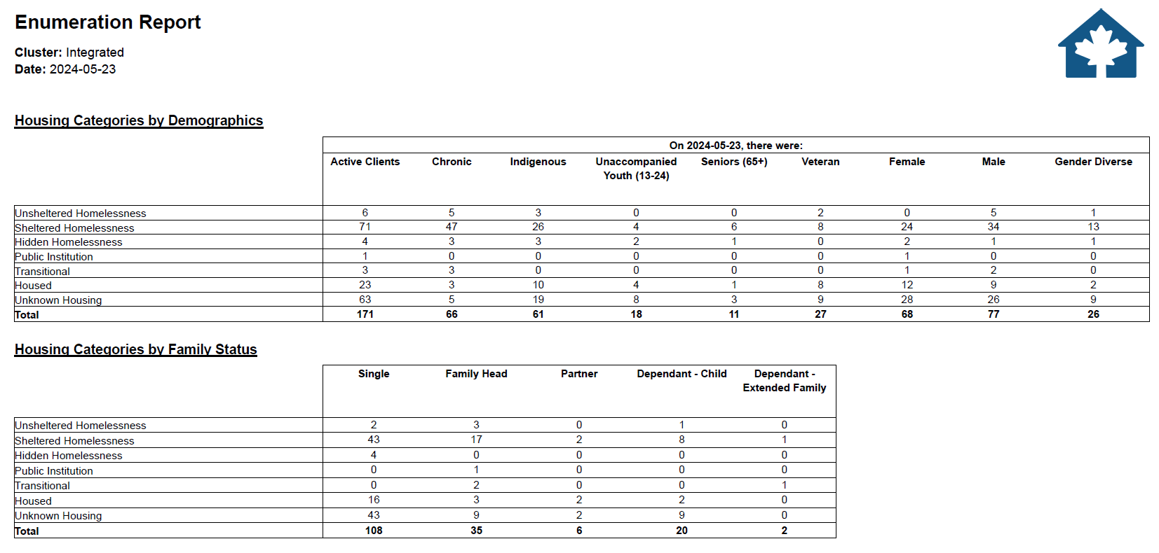
HIFIS Enumeration Report
Notes:
PiT includes standardized questions that are asked to each respondent.

Slide 11
Option 4: Compare demographic information
Compare the representation of specific populations on your community data to demographic findings from the Survey.
Differences in representation between data sources may flag:
Data quality issues: Is demographic information being adequately captured on the List?
Underserved populations: May be due to gaps in available services or avoidance of systems for some populations.
Watch for differences due to coverage (e.g. the PiT count’s inclusion of DV shelters leading to a higher representation of women) and issues related to low response rates.
Best suited for: Communities that have an established list and are looking to review data quality and coverage.
Notes:
PiT includes standardized questions that are asked to each respondent.

Slide 12
Option 4: Compare demographic information
PiT Data |  |  |  | Active Homelessness Data
Population | Surveys | % |  | Population | Count | %
Veterans | 10 | 5 |  | Veterans | 20 | 5
First Nations | 80 | 40 |  | First Nations | 120 | 30
Métis | 20 | 10 |  | Métis | 20 | 5
Inuit | 10 | 5 |  | Inuit | 4 | 1
Women | 60 | 30 |  | Women | 80 | 20
Men | 130 | 65 |  | Men | 308 | 77
Gender diverse | 10 | 5 |  | Gender diverse | 12 | 3
Youth | 40 | 20 |  | Youth | 40 | 10
Adults | 100 | 50 |  | Adults | 240 | 60
Older Adults | 50 | 25 |  | Older Adults | 80 | 20
Senior | 10 | 5 |  | Senior | 40 | 10
Total | 200 | 100 |  | Total | 400 | 100
Notes:
PiT includes standardized questions that are asked to each respondent.

Slide 13
Option 4: Compare demographic information
PiT Data |  |  |  | Active Homelessness Data
Population | Surveys | % |  | Population | Count | %
Veterans | 10 | 5 |  | Veterans | 20 | 5
First Nations | 80 | 40 |  | First Nations | 120 | 30
Métis | 20 | 10 |  | Métis | 20 | 5
Inuit | 10 | 5 |  | Inuit | 4 | 1
Women | 60 | 30 |  | Women | 80 | 20
Men | 130 | 65 |  | Men | 308 | 77
Gender diverse | 10 | 5 |  | Gender diverse | 12 | 3
Youth | 40 | 20 |  | Youth | 40 | 10
Adults | 100 | 50 |  | Adults | 240 | 60
Older Adults | 50 | 25 |  | Older Adults | 80 | 20
Senior | 10 | 5 |  | Senior | 40 | 10
Total | 200 | 100 |  | Total | 400 | 100
Consider: Are these issues of service gaps or data quality?
Or, are any due to low survey response rates? The data may not be representative
Is everyone being asked to self-identify?
Are particular services not reporting?
Notes:
PiT includes standardized questions that are asked to each respondent.

Slide 14
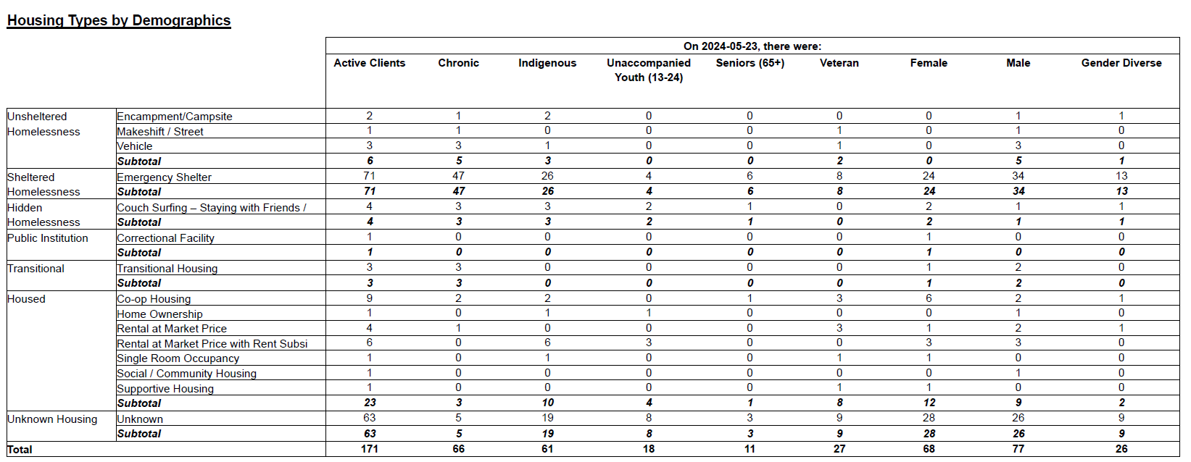
HIFIS Enumeration Report - Demographics
Notes:
PiT includes standardized questions that are asked to each respondent.

Slide 15
In sum
Joint PiT Count and Connection/ Action Sprint
To jump-start a List
Use the PiT Count as outreach for inclusion in community data
To improve List coverage, particularly in unsheltered areas.
Compare your community data to your PiT enumeration
To identify possible gaps in coverage.
Compare demographic information
To review data quality and service access.

Slide 16
Resources
Enumeration Report - Report Guide - Homelessness Learning Hub
Built For Zero Canada - Connections Week Toolkit (bfzcanada.ca)

