Slide 1
Point-in-Time Count Methodology: Extending your Survey Period
PiT Count Training June 2024

Slide 2
Outline
Choosing your survey period
Understanding effects on your data
Examples of extended survey periods in different locations

Slide 3
Extending the survey period is OPTIONAL
If the 24h period of administering surveys is working well in your community, and you wish to keep your 2024 PiT count consistent with past PiT counts in every way, you can

Slide 4
Choosing your survey period
The survey on Homelessness can be administered for up to one month
It is recommended to begin administering surveys on the day of your enumeration

Slide 5
Example of a one-day survey period
Surveys in shelters
Surveys in transitional housing
All PM surveys returned to HQ
Surveys in unsheltered areas
8 pm
9 pm
10 pm
11 pm
Stop
PM
6 am
7 am
8 am
9 am
Stop
AM
Surveys in encampments
All AM surveys returned to HQ
Surveys meal programs and other services

Slide 6
Example of a one-month survey period
Sun. | Mon. | Tues. | Wed. | Thurs. | Fri. | Sat.
1 | 2 | 3 | 4 | 5 | 6 | 7
8 | 9 | 10 | 11 | 12 | 13 | 14
15 | 16 | 17 | 18 | 19 | 20 | 21
22 | 23 | 24 | 25 | 26 | 27 | 28
29 | 30 | 31 | 1 | 2 | 3 | 4
Enumeration Night
Unsheltered Survey
Survey in Shelters
Encampment Survey
Survey in Service Locations
Survey in Transitional Housing
Survey in Shelters
Magnet Event
Survey in Service Locations
Survey in Shelters
Magnet Event
Survey in Shelters
Survey in Service Locations
Survey in Shelters

Slide 7
Why extend your survey period?
Reduces acuity of survey administration
Reduces reliance on volunteers
Increases choice and control for service providers
Facilitates engagement with harder-to-reach populations
Affords time to complete more surveys
Increases your ability to reach your target percentage surveyed for each location

Slide 8
Data considerations: Who to include in the survey
If you extend the survey period beyond a week, respondents may have a hard time identifying where they spent the night of the enumeration
If surveying over a month, you can screen in respondents who are experiencing homelessness the night prior to the survey

Slide 9
Data considerations: How might the extended survey period affect your dataset
Chronic homelessness may be lower than past PiT counts
You may be able to survey higher numbers of women, youth, people experiencing hidden homelessness or in encampments, and other harder-to-reach populations
Demographic characteristics associated with these populations may be higher

Slide 10
Examples of extended survey period:
Shelters
Staff could integrate surveys into regular work
Volunteers could be recruited to administer surveys at regular times over the month
Surveys could be administered by staff or volunteers at special events

Slide 11
Examples of extended survey period:
Provisionally accommodated
Surveys can be administered over the phone
ACT/ICMT could administer surveys during case meetings

Slide 12
Examples of extended survey period:
Encampments
Outreach staff could administer surveys in encampments according to their regular schedule

Slide 13
Examples of extended survey period:
Magnet events
Magnet events can be held in the weeks following the enumeration to avoid excessive strain on the sector on a single day or week

Slide 14
Examples of extended survey period:
Non-shelter service locations
Meal programs
Libraries
Health service locations
Crisis or triage centres
Drop-in centres
Warming centres

Slide 15
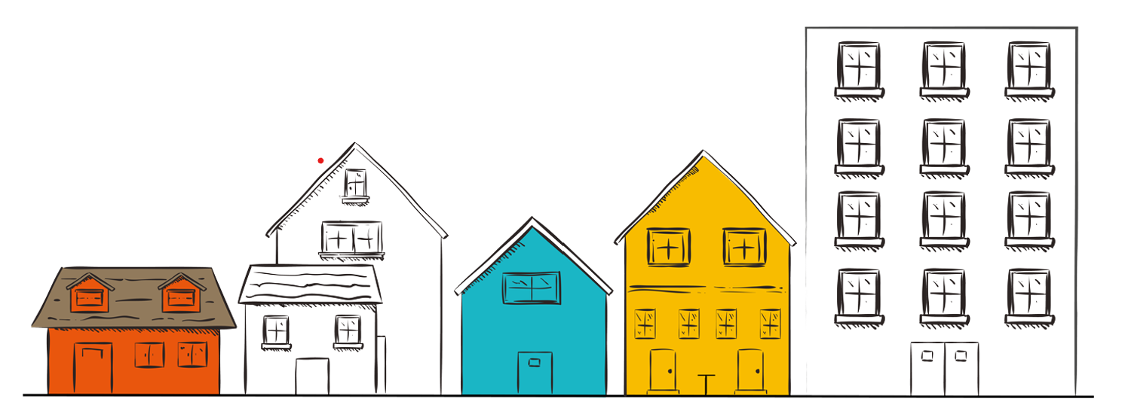
Questions?

