Slide 1



Indigenous
Municipal
Entity to Entity Parntership
Notes:
Introduction
Coalition of Hamilton Indigenous Leadership (Indigenous Homelessness – Community Entity; IH-CE)
Victoria Bomberry
Indigenous Data & Policy Analyst
policy@chieladership.com
City of Hamilton (Designated Community Entity; D-CE)
Shannon Honsberger,
Manager – Homelessness Policy & Programs
Shannon.honsberger@hamilton.ca
Kelly Coxson,
Senior Policy Analyst – Homelessness Policy & Programs
Kelly.coxson@hamilton.ca

Slide 2





Indigenous Community Entity
Designated Community Entity
Coalition of Hamilton Indigenous Leadership, Indigenous non-profit organization
City of Hamilton,
Municipality
Notes:
CHIL (IH-CE)
CHIL is a coalition of 6 Indigenous agencies in Hamilton with 4 full-time staff, 1 student and 2 project staff
We draw from our traditional teachings (Haudenosaunee and Anishinaabe) to guide our leadership work in caring and supporting the Indigenous community of Hamilton
Across all portfolios, CHIL stewards and invests approx. $5m in homelessness and poverty investments each year
City of Hamilton (D-CE)
Housing Services Division is a department with approximately 100 staff on multiple teams.
Collectively, the teams manage the development, delivery, and evaluation of housing and homelessness programs for the city.
We have teams dedicated to different components of homelessness, for example teams dedicated to capital and contracts, emergency shelter services, encampment outreach, and policy development
I (Kelly) work on the team focused on policy and coordinated access
We are also able to draw from other municipal resources and divisions. Our homelessness portfolio is funded through a mix of municipal tax dollars as well as provincial and federal funding initiatives.
Relationship
Recognizing the power and resource imbalance across entities requires both careful and intentional investments on both sides.
We have worked across multiple funding initiatives (i.e., HPS to RH) through numerous staff and leadership changes to ensure our relationship is nurtured through principles of respect, reciprocity, and shared responsibility to address and prevent homelessness in Hamilton

Slide 3





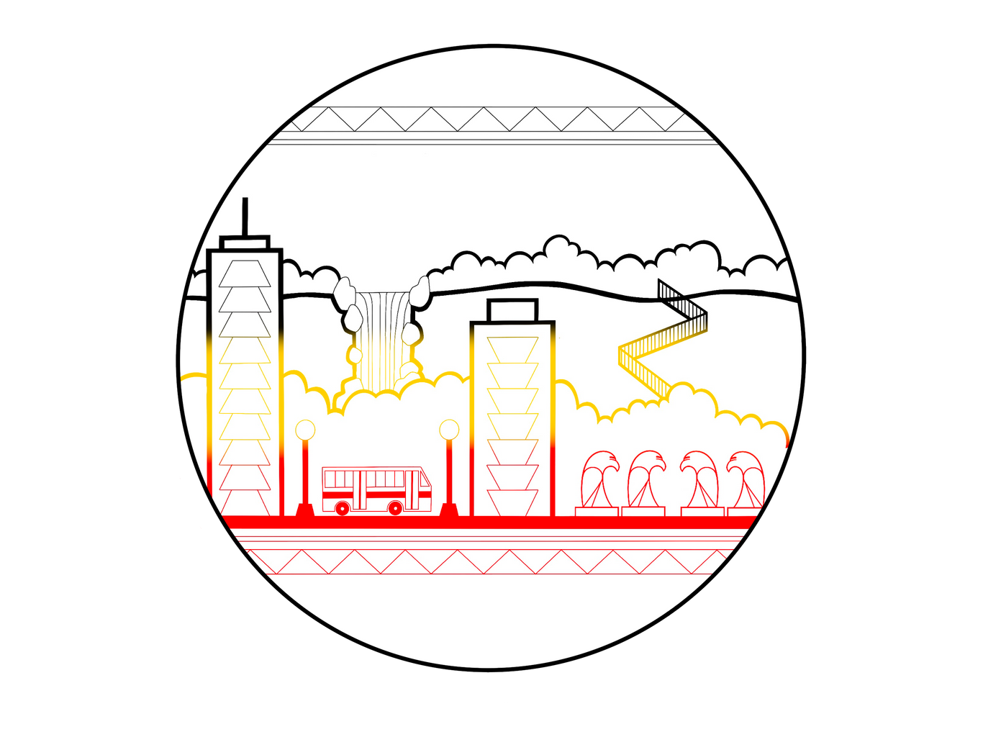
Entity to Entity
Partnership
A commitment to our city
  History
  Reconciliation
  Ongoing commitment
Notes:
History
Indigenous Peoples are overrepresented in the homeless system of Hamilton.
Indigenous experiences of homelessness and other forms of social exclusion are colonial legacies
Causes of Indigenous homelessness stem from a deep history with contemporary impacts that must be taken into consideration in our work
The interconnectedness of colonialism, residential schools, intergenerational trauma, and ongoing social and economic marginalization drive our action toward addressing Indigenous homelessness in Hamilton
Reconciliation
The City of Hamilton’s Indigenous Relations Unit manages Hamilton’s Urban Indigenous Strategy, which identifies actions and responsibilities
There is a city-wide commitment to reconciliation, which we operationalize at Housing Services through our work and partnership with CHIL
This includes working closely with CHIL in all areas of our division – service delivery, policy development and evaluation, and strategic planning
Ongoing Commitment
Our relationship with the City has stemmed numerous changes – funding initiatives (form HPS to Reaching Home) and across staff and leadership changes.
While our relationship began decades ago it requires ongoing commitment and intentional investments from both sides to nurture a respectful and reciprocal relationship
We nurture this relationship at the leadership level by having one-on-one Entity-to-Entity discussions to continually check in with each other and seek out opportunities to support each other

Slide 4


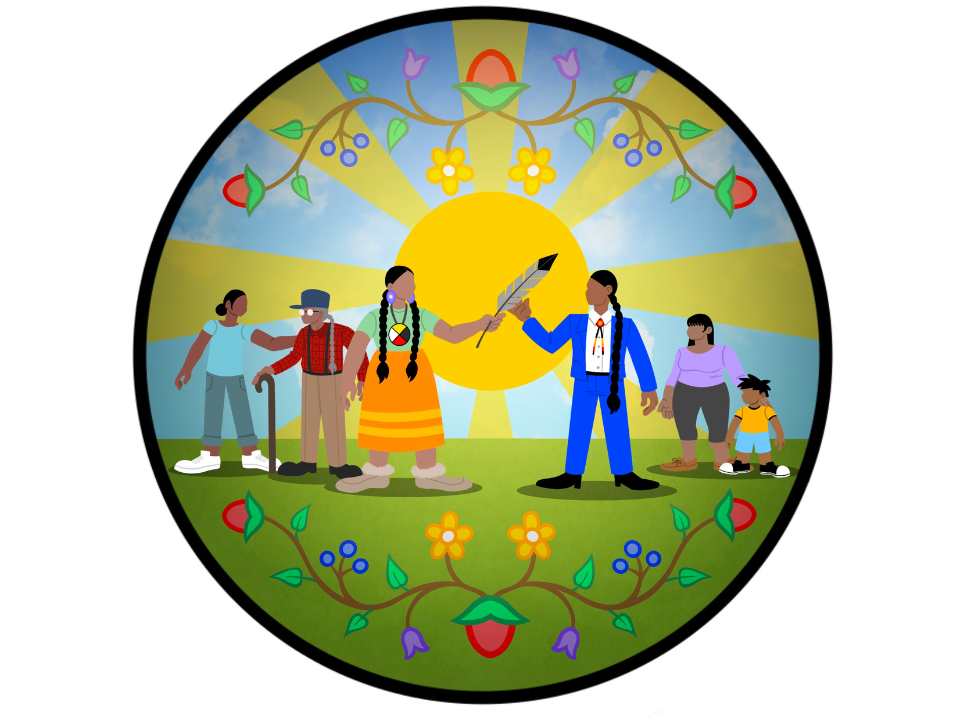
Ongoing Commitment
  Investments
  Internal changes
  System changes
Notes:
Investments
One of the most impactful investments for our partnership has been the City’s commitment to invest 20% of homelessness funding and resources to the Indigenous community
This investment includes funding, such as Reaching Home, as well as resources, such as the Housing Allowances funded by the Canada-Ontario Housing Benefit
This investment was instrumental in increasing CHIL’s operating funding to hire and maintain staff as well as increase Indigenous-led homeless programs and supports
It’s important to note that this investment is structured to enhance Indigenous leadership and autonomy. The funding is allocated such that CHIL receives the funding and allocations are directed by the expertise of the Indigenous Community Advisory Board and informed by the breadth of knowledge of our Board of Directors
Internal Changes
For the Homelessness Policy & Programs team, we attempt to build in practices throughout our work that strengthen our relationship and partnership with CHIL. Starting with onboarding new staff, we emphasize the importance of our partnerships with the Indigenous community and set up introductory meetings between new staff and CHIL.
We also attempt to structure internal discussions so that we always ask ourselves how our work impacts Indigenous peoples or should involve Indigenous partners.
This is an ongoing internal commitment to be respectful partners and continue to learn and reflect
System Changes
We have regular meetings at the director, manager, and policy level on investments, planning and service delivery.
We welcome and make space for Indigenous representation at City-led decision-making tables. Our emergency shelter coordination table is made up of shelter leadership and Indigenous agency leadership, in recognition that even if there are no Indigenous led emergency shelters in Hamilton that we all benefit from Indigenous knowledge when making decisions.
When working on funding and reporting requirements, such as the Reaching Home Community Homelessness Report, we seek input from CHIL, but aim to do the "heavy lifting" of drafting reports using information from previous projects with the Indigenous community, which then reduces the burden on CHIL and the Indigenous community advisory board when they review and approve reports.
A few years ago, we engaged in a “90 Days of Action” project in partnership with CHIL, where we formalized a new model of coordinated access which prioritizes Indigenous community members for housing related supports. This model not only prioritizes Indigenous people but also gives flexibility around privacy and assessment requirements based on recommendations from the Indigenous community. This gives our sector a clear structure for allocating resources to better support Indigenous people experiencing homelessness
Communications are clear at every system table that addressing and preventing Indigenous experiences of homelessness is a priority and requires a community-wide commitment
Example: Indigenous Peoples are prioritized at case conferencing

Slide 5

What’s next?
Action Research on Chronic Homelessness in Hamilton
A top-down approach to enhancing how coordinated access in Hamilton understands and responds to Indigenous experiences of homelessness.
Notes:
Homelessness is not stagnant and being partners in this work requires us to have open and honest discussion with each other
One of our newest initiatives is an Action Research on Chronic Homelessness project
We are developing an Indigenous cultural capacity and accountability framework to ensure every organization in our system has the capacity to understand and respond to Indigenous homelessness
This will include training to understand and respond to unique causes of Indigenous homelessness, such as intergenerational trauma
The framework is developing an Indigenous assessment process and training program for Hamilton’s homelessness system that is tailored to the different roles – Leadership, Frontline Worker’s, Managers, etc.
We’re also developing an Indigenous Data Governance and Stewardship strategy
The strategy is in recognition of the history of how data has been used against Indigenous peoples and Indigenous communities resulting in distrust and disengagement
ARCH funding has allowed us to hire 2 new team members to accelerate this work and share our progress with everyone as we go
These are just some of the practical examples of how we work Reaching Home Entity-to-Entity. We’re always happy to speak one-on-one with other communities – reachout.

