Slide 1
Canada’s Homelessness Management Information System
The Homeless Individuals and Families Information System (HIFIS)

Slide 2
Canada’s Homelessness Management Information System
Overview
HIFIS and Coordinated Access
The Evolution of HIFIS
The Benefits of HIFIS
Some Key Features of HIFIS
Data Collection
Data Sharing and Data Use
Data Protection and Data Security

Slide 3
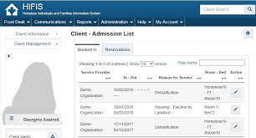
Canada’s Homelessness Management Information System HIFIS and Coordinated Access
What is HIFIS?
HIFIS is a comprehensive web-based, data collection and case management system designed to support the day-to-day operational activities of service providers and Coordinated Access
HIFIS empowers service providers from the same community to collect, manage, and share real-time data on their clients.
Why is HIFIS essential to Coordinated Access?
Supports the collection of reliable, real-time homelessness data that can be shared through a centralized database ensuring clients can be triaged appropriately and, when vacancies become available, prioritized for resources.
Reduces administrative burden. Service providers can start, update and share service plans when working with common clients. Reports can be customized to meet various needs. This helps creates a unified service experience.
Can generate data for core outcomes of Reaching Home: homelessness/eviction prevention, Indigenous homelessness, chronic homelessness, and measures of client inflow and outflow.

Slide 4
Canada’s Homelessness Management Information System The Evolution of HIFIS
1999
2006
2015
2002
2020
2022
HIFIS 1
HIFIS 2
HIFIS 3
HIFIS 4
Enhancements
Enhancements
An internal desktop application to collect data for the Government of Canada.
An internal desktop application to collect data for the Government of Canada with expanded functionalities.
A desktop application driven by the community.
A web-based application that is user-friendly and highly configurable to support the shift towards Coordinated Access.
Inclusion of the Coordinated Access module; addition of a Unique Identifier List.
Improvements to the Coordinated Access module.

Slide 5
Canada’s Homelessness Management Information System HIFIS Benefits
Clients
A client management system that eliminates the clients’ need to repeat their personal history during their intake/assessment.
A client management system that assists with referring clients to the right services at the right time.
Service Providers and Communities
A data collection and sharing system that encourages community collaboration to support service planning.
A data collection and sharing system that enables the development of reports that improve the understanding of local homelessness and housing resources
A client management system that provides access to various assessment tools that streamlines intake and prioritization process of clients.
Homeless-serving Sector
A data collection and sharing system that contributes to the national understanding of homelessness.
A data collection and sharing system that informs and advances research and policy development including identifies gaps in the sector.

Slide 6
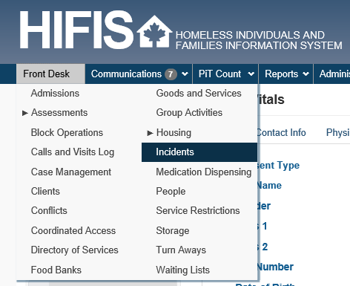
Canada’s Homelessness Management Information System Key Features of HIFIS
Key Features
Web Environment
Highly Configurable
HIFIS Support and Services
Custom Reports
Client Assessments
Point-in-Time (PiT) Counts
Unique Identifier List (By-Name List)
Integrated consent
Communication Tools (broadcasts and bulletins)
HIFIS allows for seamless service delivery. Service providers can build on each other’s service planning when working with common clients, creating a unified service experience.

Slide 7
Canada’s Homelessness Management Information System Data Collection
What types data does HIFIS collect?
Communities can collect over 1000 various data points. Communities decide what data they wish to collect (excluding the mandatory export fields).
INFC collects 38 non-directly identifiable export fields.
What are the 38 non-directly identifiable export fields, and how are they collected?
The 38 non-directly identifiable export fields are mandatory data fields collected through HIFIS and automatically anonymized and encrypted, and exported to INFC each quarter.
These fields include: Service Provider Information (e.g., service provider ID), Client Information (e.g., country of origin), Shelter Stay Information (e.g., reason for service), and Turn-away Information (e.g., reason for turn-away).
The HIFIS Data Provision Agreement is an agreement between the HIFIS Lead organization and INFC. It details roles and responsibilities, and authorizes INFC’s collection of the non-directly identifiable export fields.

Slide 8
Canada’s Homelessness Management Information System Data Sharing and Data Use
How is HIFIS data shared?
Community A
Community B
Each Community has a HIFIS lead organization that is responsible for the installation, configuration, and maintenance of HIFIS for their local community service providers.
Local Service Provider
Local Service Provider
Local Service Provider
Local Service Provider
HIFIS Lead Org.
HIFIS Lead Org.
How is HIFIS data used by INFC?
INFC
INFC uses the 38 non-directly identifiable export fields to support research and analysis on homelessness in Canada and the homeless-serving sector, which contributes to evidenced-based policy and decision-making and publications (e.g., the National Shelter Study and the Shelter Capacity Report).
Under Reaching Home: Canada’s Homelessness Strategy, the Designated Communities stream and the Territorial Homelessness stream are required to adopt HIFIS if the community does already have an equivalent HMIS in place.

Slide 9
Canada’s Homelessness Management Information System Data Sharing and Data Use
Different Levels of data sharing in HIFIS:
Layer | Area in HIFIS 4 | Examples of Fields / Modules | Privacy Details
Layer 1 | Shared Client List | Name/Alias Date of Birth/Age Gender | Shared. Most HIFIS Users can view this information.
Layer 2 | Client Information | Indigenous Status Veteran Status Financial Profile Family Status Education History Housing History | Shareable. Most HIFIS Users can view this information if their organization has attested that they are serving the client.
Layer 3 | Client Management | Admissions Service Restrictions Turnaways Goods and Services Assessments Case Management Incidents | Limited sharing. As a default in HIFIS, some details from these modules are shared between Service Providers, but full details can only be seen by Users at the Service Provider that entered the information. Locally, some of these modules may become visible across Service Providers to allow for shared service planning for mutual clients.

Slide 10
Canada’s Homelessness Management Information System Data Protection and Data Security – A Shared Responsibility
NEEDED
PROVIDED
GOVERNANCE
IT
HIFIS
ACTIVITY
Define roles & responsibilities
Define user access rights
Develop and standardize policies and procedures
Develop applicable agreements (e.g., client consent form)
Secure server
Local encryption
Firewall
Establish user-rights
Back-ups and safeguards
On-site technical expertise
Configurable access and viewing rights
Activity and audit logs
Integrated help centre
Encrypted data exports
Granular configurations at the source-code level
User-rights flexibility
The ability to be clustered
OUTCOME
Community roles, priorities, and data needs are clearly defined
Collected data are secured from accidental data loss and/or external threats
Integrated and customizable privacy functions enables data to be collected, shared, and exported securely and privately

Slide 11
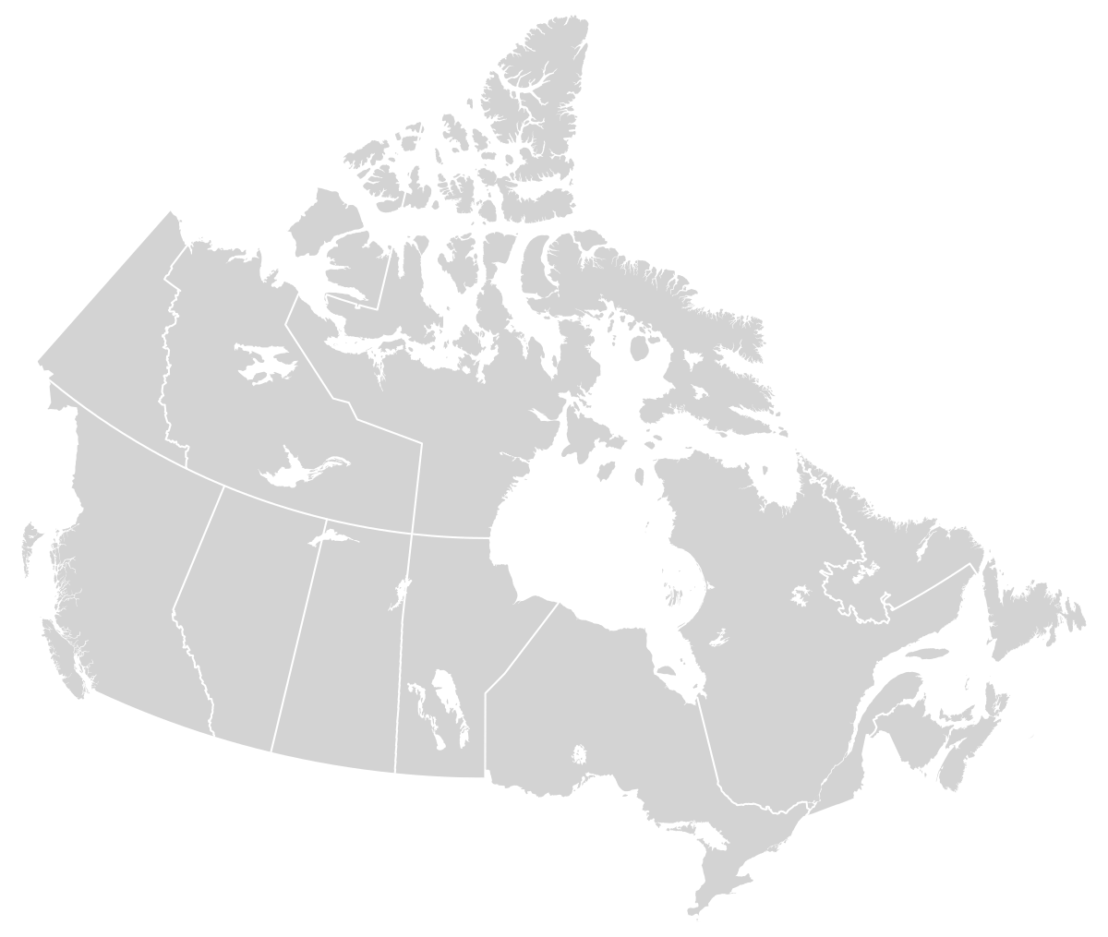
Canada’s Homelessness Management Information System HIFIS Implementation
How is HIFIS implemented in the community?
INFC develops HIFIS internally and provides
a license to our Community Entities to host,
install, and implement HIFIS locally in their
community (or in the case of some jurisdictions
– provincially).
INFC continues to maintain and update the
system – through a series of releases to address
bug fixes, and increase functionalities on key
priorities both with the community and for INFC,
such as Coordinated Access functionalities.
The community is responsible for implementing and configuring HIFIS based on the needs of their community and through community consultation – what service providers need access, what roles and responsibilities service providers have.
This includes: Planning, a Needs Assessment, Designing how that will work within the confines of how HIFIS operates, and providing training and maintaining the system.

Slide 12
How HIFIS Development gets Prioritized?
Lots of requests for enhancements
Three main groups:
Data Collection (Data In)
Data Reporting (Data Out)
Application (HIFIS Software)

Slide 13
THANK YOU Additional Resources
Coordinated Access Guide
For more information on Coordinated Access
https://www.homelessnesslearninghub.ca/library/resources/reaching-home-coordinated-access-guide
HIFIS Website
For more information on HIFIS
http://www.hifis.ca/
HIFIS Demo Site
For a hands-on experience with HIFIS
https://demo.hifis.ca/
Reaching Home Newsletter
For the latest news and updates on the Reaching Home program, please sign up to the email distribution list.
info@hifis.ca
HIFIS Newsletter
For the latest news and updates on HIFIS, please sign up to the email distribution list.
support@hifis.ca
Homelessness Learning Hub (HIFIS Toolkit)
For access to a wide range of free supporting documents on Coordinated Access, HIFIS, and Reaching Home.
https://www.homelessnesslearninghub.ca/library/resources/hifis-implementation-guide
HIFIS Client Support Center
For all inquires regarding HIFIS.
support@hifis.ca and 1-866-324-2375

Slide 14
ANNEX A The 38 Non-directly Identifiable Export Fields Collected by INFC
Shelter Information Shelter provider ID* Shelter provider name* Service provider type* Bed counts* Bed types* Community* Client Information Unique client identifier* Gender* Year and month of birth* Family role* Family head ID* Citizenship/immigration status* Indigenous indicator* Veteran status* Life events Contributing factors Contributing factor start date Contributing factor end date Employment status | Client Information (continued) Country of origin Education Sources of income Income start date Income end date Health conditions Housing types Housing start date Housing end date Client Shelter Information Reason for service* Reason for discharge* Book-in date* Book-out date* Turnaway Informaiton Reason for turnaway* Date of turnaway* Anonymous gender* Anonymous age category* Anonymous Indigenous indicator (assumed) Anonymous disability indicator (observed)

