Slide 1
ONBOARDING &
CASE MANAGEMENT
Windsor-Essex’s Strategy and
Best Practice Development
Presented by:
Myles Soulliere
Coordinator, Housing Administration

Slide 2
Agenda –
Our HIFIS journey & how we planned to board
How we actually onboard
How we use Case Management
Challenges, Questions and Answers
Open discussion and best practice development

Slide 3
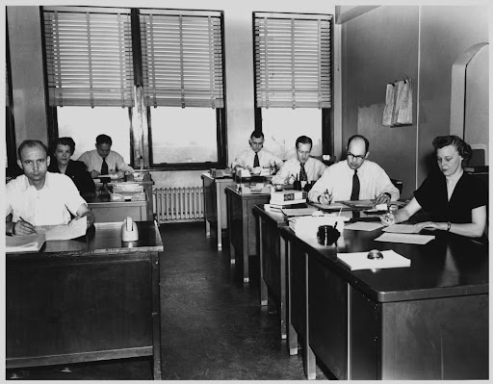
Our HIFIS Journey: where we started

Slide 4
Our HIFIS Journey: where we are heading

Slide 5
Initial Service Provider Meetings
Research, research, research
Content we cover
Training and onboarding planning

Slide 6
How we planned to onboard

Slide 7
How we actually onboard

Slide 8
Case Management and Us
5 distinct cases created
Housing Case – Funded
Housing Case – Non Funded
Shelter Case
Youth Case
Supportive Housing
Sharing of Case Notes

Slide 9
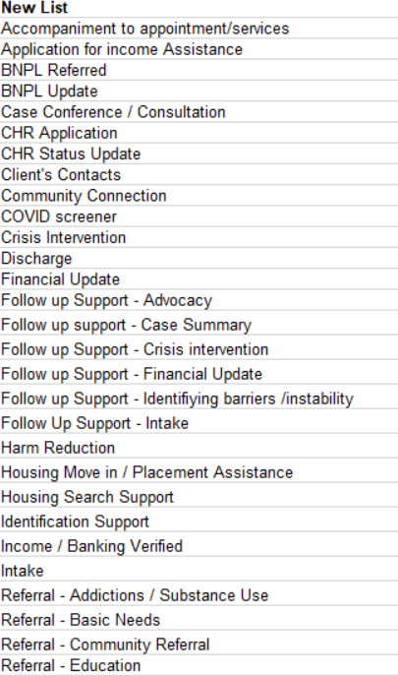
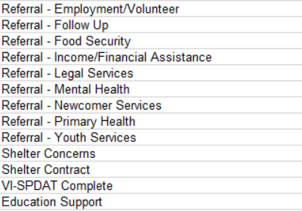
Demo Case

Slide 10
Challenges, Questions & Answers
Reporting!
Complexities of funding
“Case Viewer” rights
Q & A

Slide 11
Best Practice Development…

Slide 12
Best Practice Development-
Onboarding New Staff

Slide 13
Best Practice Development-
Using Case Management

Slide 14
THANK YOU!
Myles Soulliere
Coordinator, Housing Administration and Development
E: mLsoulliere@citywindsor.ca

