Slide 1
Report Writing and Data Mapping Guide
Homeless Individuals and Families Information System (HIFIS)
Erin Forrest (she/her)
FORREST CONSULTING
Notes:
Hello everyone. I am Erin Forrest, my pronouns are she and her, and I am speaking to you today from the treaty and traditional territory of the Michi Sagig Annishinabe from Nogojinawang Ontario, also known as Peterborough. Today I am speaking to you as a consultant, and not as the Data Administrator from the City of Peterborough (which is where many of you may know me from). I have been fortunate enough to be a part of a project to develop a guide that will assist communities in writing HIFIS reports. That is what I am here to talk about today.

Slide 2
Objectives
Review the importance and benefits of report writing
Introduce you to the Report Writing Guide
Explain some basic database concepts
Demonstrate how to use the guide to create a report
Tell you how to get the most out of the Report Writing Guide
Notes:
We have several objectives for today’s session. We’ll start by talking about the importance and benefits of writing reports. Then I’ll give you a brief introduction of the report writing guide and it’s chapters. We’ll review some basic database concepts. Then I will demonstrate how you can use the guide to create a basic report. Before we finish up I’ll give you some tips on how to get the most of the report writing guide.

Slide 3
Importance of Report Writing
Capacity
Free up staff time for more important tasks
Convenience, Speed
Data at the click of a button
Run reports as frequently as you like with little extra work
Consistent Calculations
Don’t worry about mistakes in Excel or remembering formulas
Customization
Reports can reflect local definitions, configurations, or practices
Insights & Knowledge Mobilization
Use the information to conduct program evaluation, inform service delivery, report to funders, and communicate with stakeholders
Notes:
The data that is put into HIFIS is only valuable if you can extract it, use it, and analyze it. This can take up a lot of staff time, but by writing reports that pull data exactly the way you need it, you can save you time, and ultimately money.
If a staff member can pull a list of clients who are members of a specific population, it saves them hours of sifting through spreadsheets or manually viewing HIFIS profiles.
If you have a report that you need to run on a regular basis, like performance indicators for a funding source, reports can allow you to generate a report with a few simple clicks. With a standardized report the calculations will remain the same each time you run the report, so you don’t have to worry about making a mistake with your excel formulas. This is especially handy if there is a lot of time that passes between reporting periods.
Every community has different reporting needs and might have their own definitions or calculations. As a report writer you can customize your reports so that they reflect the needs, language, and definitions of your community.
Last but not least, reports allow you to gain valuable insights into your housing and homelessness system. You can use the data you pull using your reports to conduct program evaluation, inform your service delivery, report to funders, and communicate with stakeholders.

Slide 4
How to Get Data Out of HIFIS
Crystal Reports
Pre-made reports in the Reports Manager
SQL Server Management Studio
Power BI
Tableau
Many others!
Notes:
Today we’ll be focusing on Crystal Reports but there are multiple ways you can get data out of HIFIS. The Report Writing Guide can be useful regardless of the tool you use to pull data out of the database.
In addition to custom built Crystal Reports there are pre-made reports in the reports manager. If you write queries in SQL Server Management Studio the report will still assist you in understanding the database. If you use Power BI, Tableau, or other tools…you can use the guide the understand the database and build reports the way you want them.

Slide 5
Database Concepts
The Database Concepts chapter answers the following questions:
What is a database?
How are things stored in a database?
What types of data is stored in a database?
How database tables are related?
What are primary and secondary keys?
What are table joins?
What are database views?
What is a database schema?
We’ll introduce some of these concepts today, but check out the guide for a more in-depth description!
This chapter starts on page 11 of the guide!
Notes:
In the guide you will find brief answers to the following questions:
What is a database?
How are things stored in a database?
What types of data is stored in a database?
How database tables are related?
What are primary and secondary keys?
What are table joins?
What are database views?
What is a database schema?
I’m going to give you a quick overview of some of these things today to help you follow along with the demonstration I’ll be doing a bit later on. Be sure to check out the chapter called “Database Concepts” in the guide for full answers to each of these questions…it starts on page 11.

Slide 6
Database Concepts
What is a database?
A way of storing and organizing information
Often located on a server (computer that is always on and providing a service, that is accessible via the internet or local network)
Benefits:
less redundancy,
good for big data sets,
more protection from accidental damage, corruption, or disorganization
Challenges:
need the help of database professionals to set-up and maintain
data can be harder to extract
Notes:
Let’s start with the most basic question: what is a database? It is simply a way of storing and organizing information.
Databases are often located on a server (another word for a computer that is always on and providing a service, that is accessible via the internet or local network)
Databases are less redundant than other storage methods (like excel) and they handle large data sets with ease. They also offer more protection from accidental damage, corruption or disorganization. The challenges of working with a database can include the need for help from database professionals and the difficulty in extract the data fropopm the database in a meaningful way.

Slide 7
Database Concepts
What is a database made of?
A collection of tables…containers for data
They are made up of fields, records and values
The proper way to refer to a field is to mention the table then field name (e.g. HIFIS_People.PersonID)
Values can be words, numbers, letters, dates, times, monetary values…and more!
PersonID | FirstName | LastName | DOB
1 | Alex | Smith | 1998-11-09
2 | Brando | Johns | 1977-03-14
3 | Catsy | Miller | 2001-01-29
4 | Drew | Stevens | 1983-08-07
Record
Value
Field
Notes:
A database is made up of a collection of tables. Tables are essentially containers for data.
A table is similar to an excel sheet…it has fields, records, and values.
A field represents a piece of information like an ID number, name, or birthday.
A record represents a fields that are related…such as the ID name and birthday for a specific person.
A value is a single piece of information. There are many types of information that a database can store: words, numbers, dates, times, monetary values, and more!
How many database tables do you think there are in HIFIS? It’s a lot! As of version 59.4 there are 564 tables.

Slide 8
Database Concepts
How are database tables related?
Tables use ID numbers to show a link to another piece of information
These are called ‘keys’
In HIFIS you can create Clients and People
Clients are the individuals and families you serve
People are involved with your Clients’ service (landlords, case workers…)
Everyone is a ‘Person’…but not everyone is a ‘Client’
To make the storage of data efficient, common attributes of a person are stored in a database table called HIFIS_People
Additional information that only relates to clients is stored in the HIFIS_Clients table
Notes:
How are database tables related? One of the reasons databases are so efficient is that they split information up into many tables, and refer to each other when necessary. They do this using ID numbers to show when there is a link (or a relationship) to another piece o information. These are called ‘keys’.
Lets look at a HIFIS specific example. As some of you may know, you can create both clients and people in HIFIS. Clients are the individuals and families you serve and people are involved in some other way with your client’s service. They can be landlords, case workers, doctors, family members, etc.
In the HIFIS database there is a table called HIFIS_People and it contains records for both clients and people. There is also a table called HIFIS_Clients that holds additional information for anyone who is a client. The people table holds names a birthdays. To ensure there is no duplication of information,

Slide 9
Database Concepts
HIFIS_Clients table
HIFIS_People table
ClientID | PersonID
1101 | 1
1102 | 2
1103 | 3
1104 | 4
PersonID | FirstName | LastName | DOB
1 | Alex | Smith | 1998-11-09
2 | Brando | Johns | 1977-03-14
3 | Catsy | Miller | 2001-01-29
4 | Drew | Stevens | 1983-08-07
Foreign Key
Primary Key
Primary Key
Tables can only have one Primary Key, but they can contain many Foreign Keys that refer to other tables.
Notes:
Let’s take a closer look at the relationship between the HIFIS_Clients table and the HIFIS_People table.
In this slide I have only chosen a few columns for each table so that it fits nicely on the slide, but in the database both these tables contain a wealth of information about People and Clients.
The HIFIS_People table is on the top right. It has a field for PersonID :this is called a Primary Key and every Person in the person table has a primary key that is unique to them. No two people can have the same Primary Key. This table also includes the names and birthday’s of every person in HIFIS.
The HIFIS_Clients table is on the bottom left. It has a field for ClientID: this is the Primary Key for the table and every Client in the clients table has a primary key that is unique to them. No two clients can have the same Primary Key.
You will notice that there are no names or birthdays in the Clients table. Instead of repeating this information, there is simply a field that tells you which person the record relates to. When the primary key of another table is used to show this relationship, it is called a ‘Foreign Key’.
Tables can only have one Primary Key, but they can contain many Foreign keys that refer to other tables.

Slide 10
Database Concepts
Joining Tables
Joins are used to combine the information between two or more tables
This is important to understand, because when done incorrectly you can misinterpret your data, especially if you are counting or summarizing data
For example, lets combine the HIFIS_People table and the HIFIS_PeopleCars table
Table1
Table2
Table1
Table2
PeopleCarID | PersonID | Model
201 | 1 | Civic
203 | 3 | Focus
204 | 3 | Camry
205 | 4 | Elantra
PersonID | FirstName | LastName | DOB
1 | Alex | Smith | 1998-11-09
2 | Brando | Johns | 1977-03-14
3 | Catsy | Miller | 2001-01-29
4 | Drew | Stevens | 1983-08-07
Table1
Table2
Foreign Key
Primary Key
Notes:
When we need to combine information from multiple tables we call this a Join. Joins are important to understand because when done incorrectly you can misinterpret your data, especially if you are counting or summarizing data.
For example, lets combine the HIFIS_People table and the HIFIS_PeopleCars table.
The person table is on the right, and it has the PersonID, names and birthdays in it. The cars table is on the left and it has a Foreign Key linking the record to the people table. It also lists the model of the car.
If we look closely at the data in the PersonID field of the cars table we can see that Persons 1 and 4 have one car, person 3 has two cars, and person 2 doesn’t have any.
Let’s see what happens when we combine them to give us a list of the cars and their owners.

Slide 11
Database Concepts
Joins are explained starting on page 17 of the guide!
Joining Tables
You can see that we have 4 car records, but only 3 unique people. Person number 2 (Brando Johns) is not included in this new combined table because they don’t have a car. This is called an inner join.
There are other ways we could have joined this table to include Brando Johns leaving the fields about the car blank. Check out the guide for more ways to join tables.
PeopleCarID | PersonID | Model | FirstName | LastName | DOB
201 | 1 | Civic | Alex | Smith | 1998-11-09
203 | 3 | Focus | Catsy | Miller | 2001-01-29
204 | 3 | Camry | Catsy | Miller | 2001-01-29
205 | 4 | Elantra | Drew | Stevens | 1983-08-07
Notes:
If we perform an inner join, we will get a new table that lists all the cars and their owners. You can see that we have 4 car records, but only 3 unique people. Person number 2 (Brando Johns) is not included in this new combined table because they don’t have a car. This is called an inner join.
Inner Joins are explained in more detail, along with other types of joins, in the report writing guide.
There are other ways we could have joined this table to include Brando Johns leaving the fields about the car blank. Check out the guide for more ways to join tables.

Slide 12
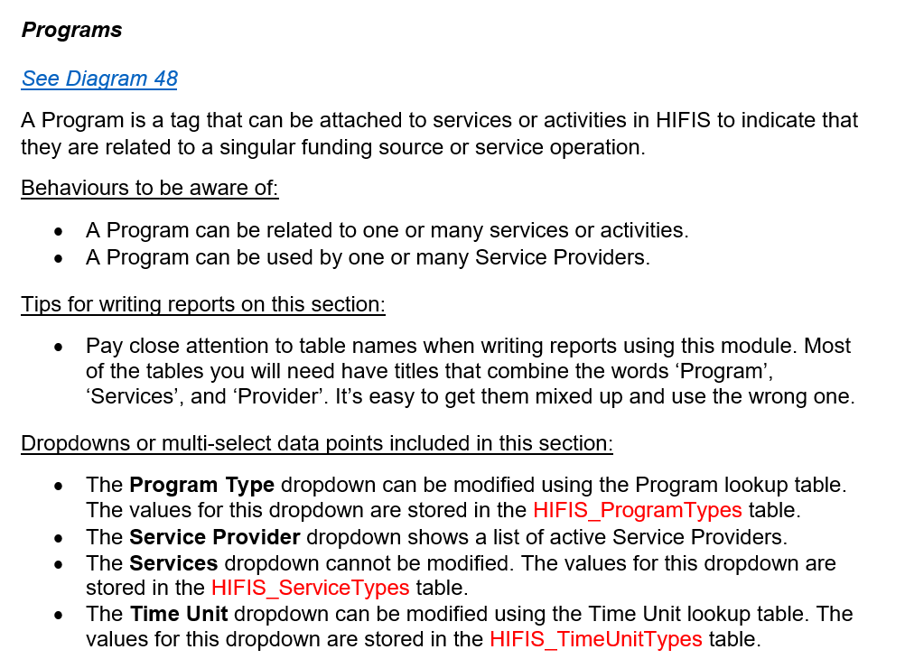
Module Descriptions
Lists the diagram(s) associated with the module
Brief description of module use
Highlights unique/notable behaviours of the module
Lists tips for writing reports on the module
Lists the dropdowns in the module and their associated look-up tables and database tables
Notes:
Now that we understand some basic Database concepts lets look at the contents of the report writing guide. One of the features of the report writing guide are the module descriptions.
The descriptions will list the diagrams associated with the module and:
talk about how the module is used
highlight unique or notable behaviours
provide tips for writing reports on that section
list the dropdowns that are in the module along with their associated look-up tables and database tables.

Slide 13
Database Diagrams
At least one diagram per module
Each diagram contains:
Boxes that represent database tables
Primary Keys
Foreign Keys
Symbols representing the relationships between tables
You can learn what the symbols mean on page 14 of the guide!
Notes:
Each module of HIFIS will have at least one diagram associated with it. Some diagrams will contain multiple modules. Some database tables appear in multiple modules.
Each diagram will have boxes that represent database tables. The primary key for that table will be listed in the box. There will be a line representing the relationship between two tables. The foreign key will be alongside the line that represents the relationship.
There will be symbols at the ends of the lines that represent the type of relationship between the tables. If you remember a couple slides ago we talked about cars and people. The symbol on the diagram in on the slide demonstrates that a person can have zero or many cars, but there can’t be any cars without owners.
It may take some time to get used to the symbols, but many of the relationships are common sense, and you will already be familiar with them if you have experience using HIFIS. Check out page 14 of the guide for a full explanation of these relationship symbols and what they mean.

Slide 14
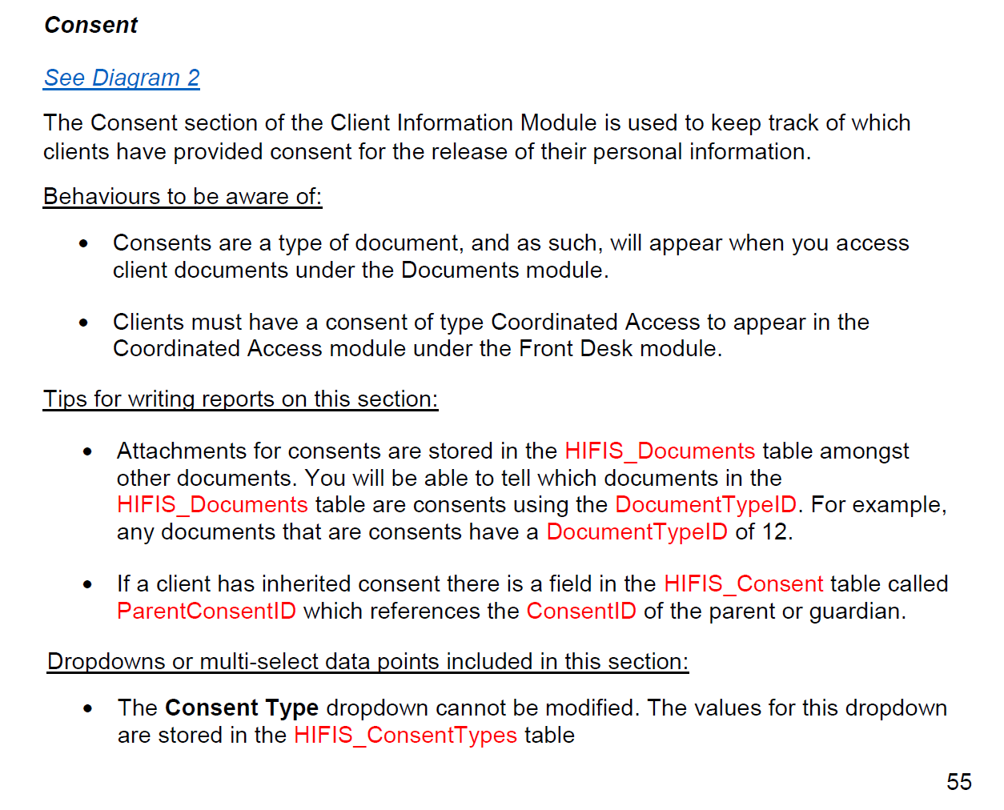
Demonstration
I will demonstrate how to create a report using the guide that lists all the clients who are currently active, and what type of consents that they have.
First, lets see if the guide has any tips!
Information about the Consent Module can be found on page 55 of the guide.
For this report I will also want to review the section that explains the Client Vitals section of the Client Information module, which is found on page 51.
Notes:
I will demonstrate how to create a report using the guide that lists all the clients who are currently active, and what type of consents that they have.
First, lets see if the guide has any tips!
Information about the Consent Module can be found on page 55 of the guide. It tells us to see Diagram 2 for more information. It also tells us that clients must have Coordinated Access consents to appear in the Coordinated Access module. Perhaps our report can help us determine who is missing CA consent!
For this report I will also want to review the section that explains the Client Vitals section of the Client Information module, which is found on page 51. It tells us to see diagram 1 for more information, and it also explains the relationship between the clients and peoples tables…which we’ve already talked about.
There’s more interesting info in the guide about those modules, but I don’t think we need them for this report. Let’s check out the diagrams.

Slide 15
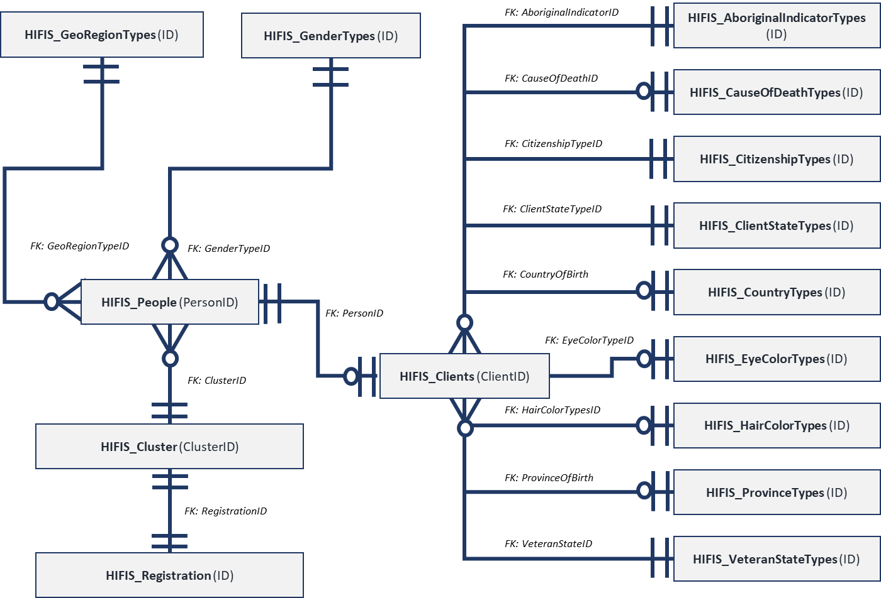
Demonstration
Let’s review Diagram 1 and decide what info I need in my report.
Diagram 1 has a lot of tables with information I don’t need.
The only tables I’ve decided I need in my report are:
HIFIS_People so I know their names
HIFIS_Clients so I know they are clients
HIFIS_ClientStateStypes so that I know they are active
Notes:
Next, let’s review Diagram 1 and decide what info I need in my report. Diagram 1 has a lot of tables with information I don’t need.
After reading the module description I can make informed decisions about what tables I want to include in my report.
The only tables I’ve decided I need in my report are:
- HIFIS_People so I know their names
- HIFIS_Clients so I know they are clients
- HIFIS_ClientStateStypes so that I know they are active

Slide 16
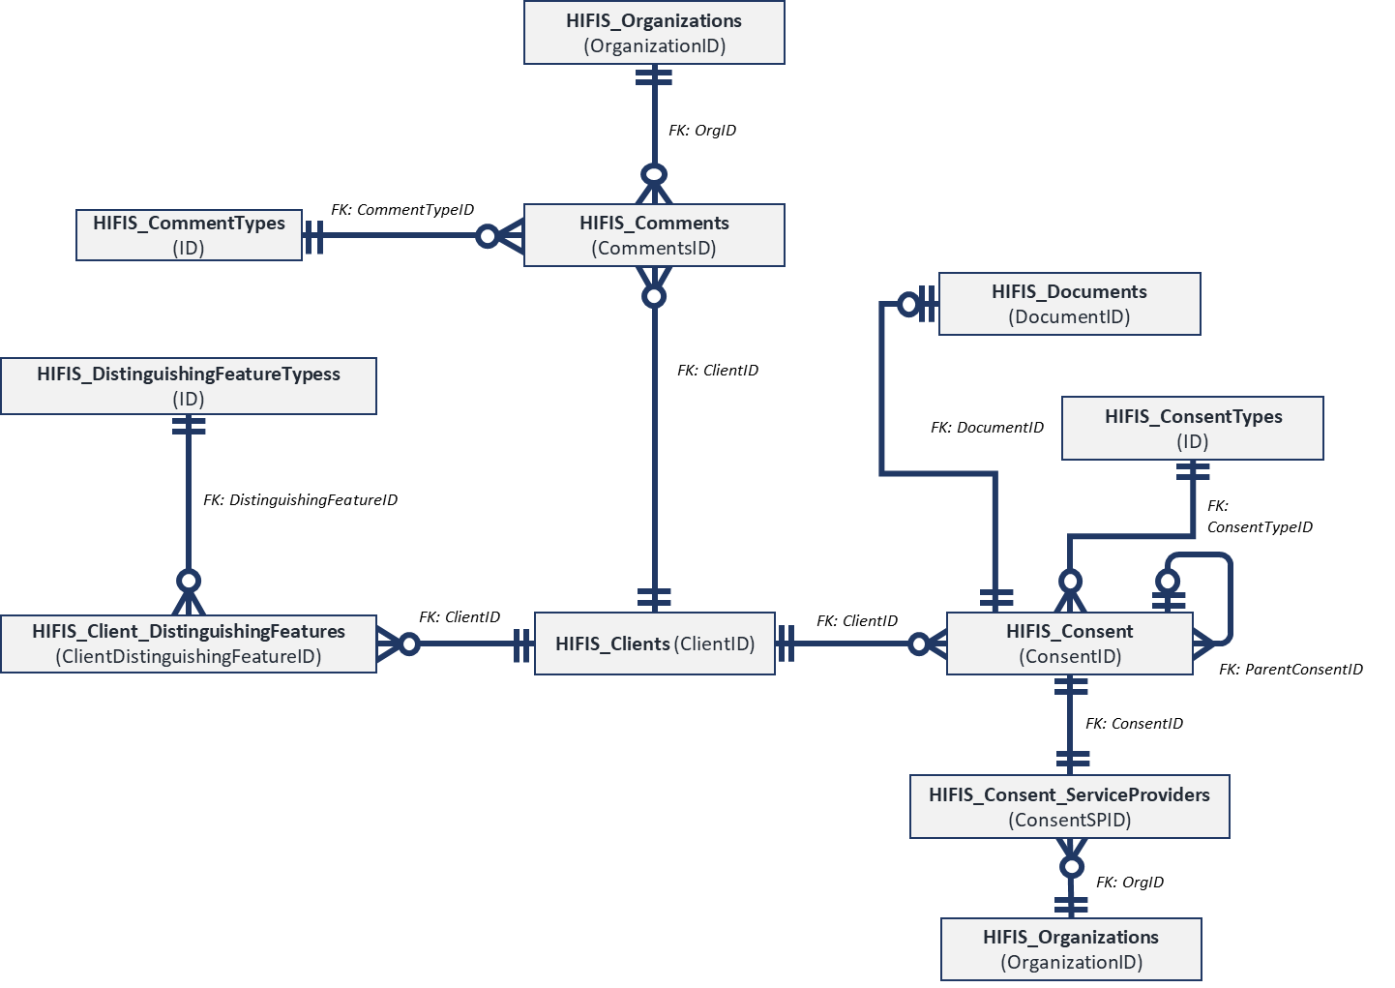
Demonstration
Let’s review Diagram 2 and decide what info I need in my report.
Diagram 2 also has a lot of tables with information I don’t need.
I already know I will be including HIFIS_Clients in my report.
The only tables from Diagram 2 I’ve decided I need in my report are:
HIFIS_Consent so I know who has consents on file
HIFIS_ConsentTypes so I know what types of consent they are
Notes:
Now we can review Diagram 2 and decide what info I need in my report. Diagram 2 also has a lot of tables with information I don’t need.
I already know I will be including HIFIS_Clients in my report.
The only tables from Diagram 2 I’ve decided I need in my report are:
- HIFIS_Consent so I know who has consents on file
- HIFIS_ConsentTypes so I know what types of consent they are

Slide 17
Demonstration
Step 1: Open Crystal Reports, select File from the main menu, then New, then Standard Report.
Step 2: Select your database from the Available Data Sources section and click on each of the tables we are including in this report. When all the tables appear on the right under Selected Tables click next.
Step 3: Review the links depicted for the database tables under the Links tab. Click on the lines to ensure the Primary Keys and Foreign Keys are properly matched. Click Ok. When the Fields Window appears just click Finish.
Step 4: Select File from the main menu and ensure that Save Data with Report is not checked. Save your report and give it a name.
Step 5: Add HIFIS_Clients.ClientID, HIFIS_People.FirstName, HIFIS_People. LastName, HIFIS_ConsentType.NameE, and HIFIS_ClientStateTypes.NameE to the details section of the report.

Slide 18
Demonstration
Step 6: Select Report from the main menu, then Group Expert. When the window appears, choose the HIFIS_Clients.ClientID and click Ok. Move the FirstName and LastName fields to the Group Header.
Step 7: Select Report from the main menu, then Select Expert, then choose Record. Add a filter so that only clients whose HIFIS_ClientStateTypes.NameE value is ‘Active’ appear in the report.
Step 8: Locate Formula Fields in the Field Explorer, right click on it and select New. Name the function ‘CA_consent_counter’.
Step 9: Write a formula so that if HIFIS_ConsentTypes.NameE is equal to ‘Coordinated Access’ the formula returns a 1, if not return a 0. Save the formula and drag it into the Details section of the report.
Step 10: Select Insert from the main menu and then Summary. Add a summary to all group levels that calculates the SUM of the CA_consent_counter. Drag the sum from the Group footer to the Group header.

Slide 19
Demonstration
Step 11: Select Report from the main menu then choose Select Expert, then select Group. Create a filter to remove all groups where the SUM of CA_consent_counter is 1 or higher.
Step 12: Right click on the Details section of the report and then click Suppress.
You now have a report that lists all active clients who do not have Coordinated Access Consent on file!

Slide 20
Other Features of the Guide
Look-up table quick reference
Lists all dropdowns in HIFIS in alphabetical order, their associated look-up table, and associated database table
Full Table List
A simple list of all tables in alphabetical order – perfect for checking your spelling!
Unused Tables List
A list of all the database tables that are not in use – don’t bother building them into your report!
Unused Fields List
A list of the database fields that are not in use – don’t bother building them into your report!
Notes:
Before I leave you for the day there are a couple other features of the guide that I want to make you aware of.
There is a quick reference guide for look-up tables that lists all dropdowns in HIFIS in alphabetical order, their associated look-up table, and associated database table.
There is a full list of all the tables in alphabetical order – a perfect tool for checking your spelling!
There are also lists of unused tables and fields. I’ve tried to exclude them from the diagrams, but if your report isn’t working as planned, use this list to see if you have referenced an empty table or column.

Slide 21
Get the Most Out of the Guide
Find the document on Homeless Hub
For ease of use, get it printed and bound
Download Crystal Reports
Connect to your server – contact your IT department
Complete the “Try it Yourself!” activity
Create a basic report that lists clients and their demographics
Learn how to sort, filter, group data, and run your new report
Calculate summaries, use formulas
Configure your reports to accept user-selected parameters
Try modifying an existing report – always make a copy of the original first!
Use the guide to create custom reports and help further your goals of ending homelessness!
Complete the “Try it Yourself!” activity on page 24 of the guide!
Notes:
I encourage you to get the most out of the guide by first, downloading the guide from the Homeless Hub. You can get it printed and bound if you wish – I find the diagrams easier to look at in print.
Download Crystal Reports to your computer…a single license is around $500 or you can email the SAP store and ask them nicely to give you a product key for older version like 2013 that work just fine.
Once you’ve downloaded Crystal Reports you will have to ask your IT department to help you connect to the database – this shouldn’t be a problem – you won’t be able to make any changes to the database, just access it.
Then you should take a look at the “Try it Yourself” Activity on page 24 of the guide. I can’t stress enough how valuable that activity can be at getting you comfortable with Crystal Reports. It will walk you through creating a basic report that lists clients and their demographics. You will learn how to sort, filter, group data, and run your new report. You will calculate summaries and use formulas. You will also learn how to configure your reports to accept user-selected parameters.
Once you’ve done that, try customizing an existing report – but always save a copy of the original first in case you break it!
Then you are free to use the guide to create custom reports and further your goals of ending homelessness!

Slide 22
Thank You and welcome to the world of reporting!
Erin Forrest (she/her)
FORREST CONSULTING

