Slide 1
Everyone Counts 2020 Mobile Point-in-Time Count Data Entry
Reaching Home Point-in-Time Count Coordinator Workshop
October 2019

Slide 2
What is mobile data entry?
PiT Counts have typically been conducted using paper forms that then have to be entered after the count night into an electronic database.
This can be time consuming and costly. In larger communities, over 1000 surveys are done and have to be entered.
This can also introduce human error, through the interpretation of ambiguous entries or through wrong clicks.
An alternative is to have interviewers directly enter survey responses on a mobile platform, using a smartphone, tablet or other mobile device.

Slide 3
HIFIS 4 Web App
A web app version of HIFIS is available that has been optimized for mobile devices.
A PiT Count Module interface can be accessed through the browser, allowing interviewers to conduct the survey on a mobile device
Information collected would align with ESDC data requirements.
HIFIS.CA

Slide 4
Advantages of Mobile Data Entry
Data Quality and Privacy
Reduced chance of misinterpreting selected responses, since the interviewer will be clicking on a specific response option
Data can be backed up, so there it is less likely that a survey can be lost
Data can be encrypted for security
Data Availability and Analysis
Can track the count in real time, and geotag responses to identify hot spots.
Can create a dashboard of results as they come in.
Data are immediately available for cleaning and analysis, expediting reporting and exporting

Slide 5
Advantages of Mobile Data Entry
Convenience & Accessibility
Most volunteers will have a cellphone with them.
Interviewers are not limited to the number of survey forms they have.
Efficiency
Reduced need for paper and printing.
Reduced set-up time for transporting survey forms to various survey locations.

Slide 6
Requirements for Mobile Data Entry
Technology
Determine the required specifications for the devices that will be used
Acquire a server that can accommodate the level of traffic
Create contingency plan for server issues on the day of the count
May need external access to servers through a VPN
Data Security
Ensure that any data stored on devices is removed on upload to reduce the likelihood that it is improperly accessed. For HIFIS, the data are not stored on the device
Ensure follow-up if a device fails to upload to the server or loses power or connectivity
Training
Plan for tech support and user training
Adopt a user-centered design that is intuitive

Slide 7
Requirements for Mobile Data Entry
Data privacy requirements
Ensure that your data management plan meets relevant data privacy requirements (e.g. having a server based in Canada)
Protection of Information
Once transferred to the server, the data should be erased or deleted from the device
Multiple response options
The system chosen should have the possibility of having both single select and multi-response options for the questions.
If you are planning to use a mobile survey platform other than HIFIS, contact us: hpsr@hrsdc-rhdcc.gc.ca
We can provide assistance to ensure collected data meet PiT Count data requirements

Slide 8
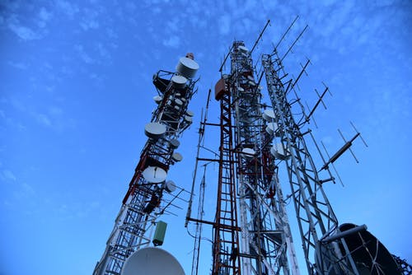
Planning for Mobile PiT Counts
Verify cellphone network coverage in areas where surveys will take place. Some routes may require paper surveys.
Interviewers should come with fully-charged phones. May bring a portable power bank if they have one.
If personal devices are used, interviewers should be aware that the app will use their own data plan.
Interviewers should not take photos of survey respondents.
Smaller communities may rent devices for the purpose of the count.
Have some back-up surveys at headquarters.

Slide 9
Thank you! Questions? Comments?
Everyone Counts 2020
The images in this presentation are from Pexels.com

