Slide 1
Registry Weeks and By-Name Lists
2018 PiT Count Coordinator Training Workshop

Slide 2
What is a Registry Week?
A kick-off or acceleration event to end homelessness in your community
A proven intervention, developed and tested in the 100,000 Homes Campaign
A week long, community driven effort to learn every person experiencing homelessness by name
A mechanism to collect actionable data on people currently experiencing homelessness & plan for moving them into permanent housing

Slide 3
Where Have Registry Weeks Been Done?
186 communities in the United States as a part of the 100,000 Homes Campaign
20 communities in Canada as part of the 20,000 Homes Campaign with (of which 8 were combined with a PiT in 2016)
Communities in Australia – Advance to Zero
Cities in Europe – End Street Homelessness Campaign

Slide 4
Count Similarities and Differences
 | Is it a count? | Is it time-bound? | Does it have identifying info? | Does it include a common assessment? | What is Actionable? | Based on System Contact?
PiT Count | Yes | Yes | No | No | Aggregate | No
Registry Week (leads to By-Name List) | Yes | Yes | Yes | Yes | Aggregate & Individual | No
By-Name List | Yes | No – on-going | Yes | Yes | System & Individual | Yes
20,000 homes campaign
Notes:
Given the new enumeration requirements and options in Ontario, thought it would be helpful to summarize what a Registry Week and By-Name List is in comparison to other count methodologies.
We have the three enumeration options down the left hand-side (PiT, Period Prevalence Count, and Registry Week), as well as a By-Name List. Along the top we have a series of questions.
The first – is it a count of people experiencing homelessness? – yes all of these are forms of a count – however for a Registry Week, the count is a by-product and not its primary purpose which is to take individual level action – to identify and assess people for offers of housing, focused on those who are the most vulnerable – and which kick-starts the development of a By-Name List. Ideally, a By-Name List can be used as a form of real-time enumeration that you could snap-shot for any particular day to provide a point-in-time count, however, By Name Lists are not yet well enough developed across Ontario to be considered as an enumeration option at this time by the Province.
What is the time-frame? A PiT takes place within a 24 hour period, a Period Prevalence can be up to one week or two or longer, a Registry Week surveying generally takes place over up to three days within a week with reporting back on results within that week, while a By-Name List is on-going data collection. A Registry Week really is a form of Period Prevalence that is shorter and collects identifying information which moves us into the next question.
Does it have identifying information? The first two - PiT and Period Prevalence - collect anonymous data - a PiT reduces double counting by limited to a 24 hour time period while a Period Prevalence uses an anonymous unique identifier. A Registry Week and By-Name List collect by-name information with people’s consent – for those that don’t yet consent which is generally 10% or less, you can continue to outreach and engage with them over time.
Does it include a common assessment? The first two don’t while a Registry Week and By-Name List do to gather information necessary to prioritize and offer support. The assessment tool can be of the communities choosing and both the VI-SPDAT (ore widely) as well as the VAT in some instances have been used across the country.
Based on this what is actionable? The data from PiT and Period Prevalence can be used at an aggregate or system level. The data from a Registry and By-Name List can also be used both at a systems level to support people directly and in the case of a By-Name List in a real-time way.
The first three are not based on system contact necessarily with staff and volunteers really providing a different level of outreach than may be regularly available in your community. However once communities have a quality By-Name List and strong coordinated system of service and street outreach, By-Name List service data can be very thorough data as well.

Slide 5
What is Unique About a Registry Week?
Asking people’s names (with consent)
Common assessment to understand acuity
Community debrief within the week
Focus on follow-up and action – housing people – engaging community
Start of a By-Name List

Slide 6
Why Do A Joint PiT/Registry Week?
A Registry Week is flexible to combine with any other method and allow for local approaches
HPS supports you in conducting a joint process and including a Registry Week at any point – even if not already indicated so in your proposal or plans
Leverage your time and the resources you have been provided to have the greatest impact
Position yourself to meet goals to end chronic homelessness
Position yourself to participate in 20KHomes

Slide 7
Tools and Support
The Musts:
Federal - Everyone Counts: A Guide to Point-in-Time Counts in Canada
The Tools:
Community Workspace on Homelessness & PiT Count Toolkit
Registry Week - www.20KHomes.ca
Registry Week Toolkit
Sample Introductory Script, Screening, Tally and Consent
2018 Joint PiT/Registry Packet and Joint Survey Tools
By-Name List page
20KHomes Update and HIFIS Update (PiT Module & BNL) Dec 7th 1-2:30pm EST – register here
Joint PiT/Registry Q&A - January 16, 2018 from 1-2:30pm EST– register here

Slide 8
Going Forward: By-Name Lists
Real-Time Data:
Data collected and tracked in a consistent, timely fashion (hint: as often as possible!) to help you understand today’s landscape.

Slide 9
What is a By-Name List?
A By-Name List (BNL):
Is a real-time list of all people experiencing homelessness.
It includes a robust set of data points that support:
coordinated access and service prioritization at a household level; and
an understanding of homeless inflow and outflow at a system level.
This real-time actionable data supports triage to services, system performance evaluation, and advocacy (for the policy changes and the resources necessary to end homelessness).
20,000 homes campaign
Notes:
Real time-list of all people – consent to be on list and assessment, consent only to be on list, don’t consent to anything still on your radar (count them)

Slide 10
The Universe of All Experiencing Homelessness
Those That You Know Exist (Though May Not Know Name)
Provided Consent & Know Name
Engaged in Services (Active)
Imminently House-able
(All Paper Work in Order)

Slide 11
Everyone that is homeless
Those you know exist
}
Coordinated Access List
Those that consent
Those eligible &
engaged
}
Those
you have all paperwork done
Priority
List
By Name List
Unknowable
Anonymous

Slide 12
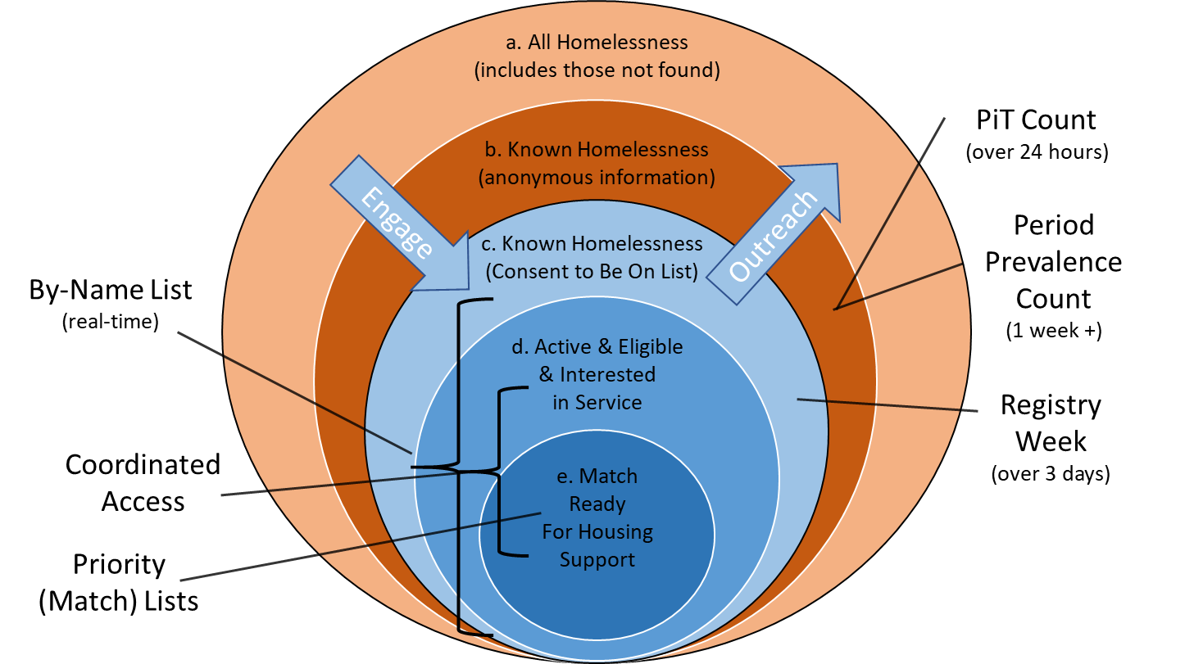
By-Name List - Nesting Concepts
Notes:
Walk through diagram.
Can think of working to have c) be the entire universe of people experiencing homelessness that is known and consent to be on the list or in your database – continue to reach out to those unknown and not currently interested in sharing their information to ensure By-Name List is as complete as possible.

Slide 13
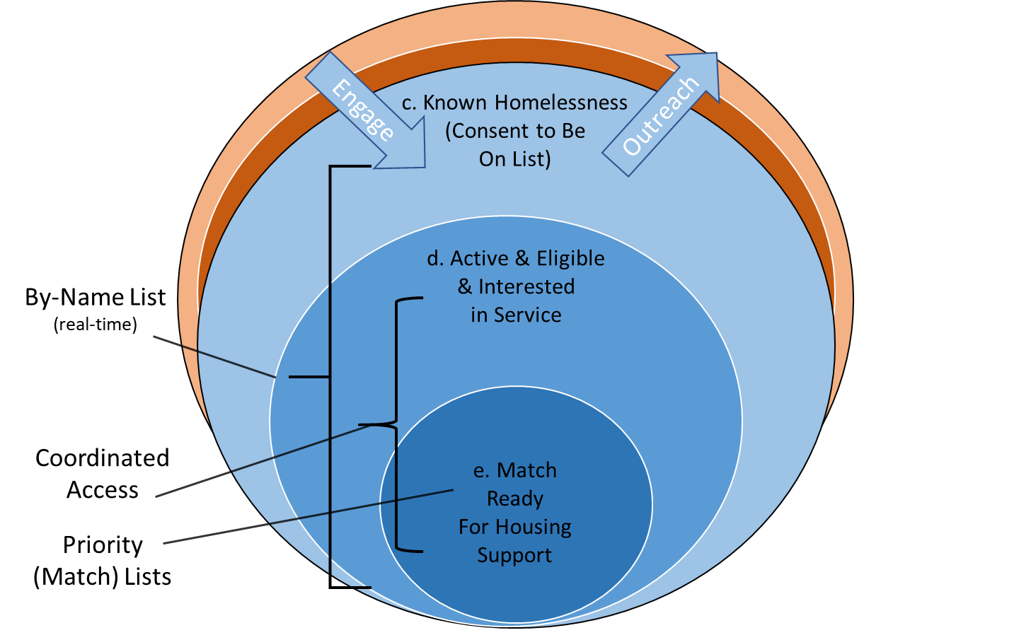
By-Name List - Nesting Concepts
Notes:
Can think of working to have c) be the entire universe of people experiencing homelessness that is known and consent to be on the list or in your database – continue to reach out to those unknown and not currently interested in sharing their information to ensure By-Name List is as complete as possible.

Slide 14
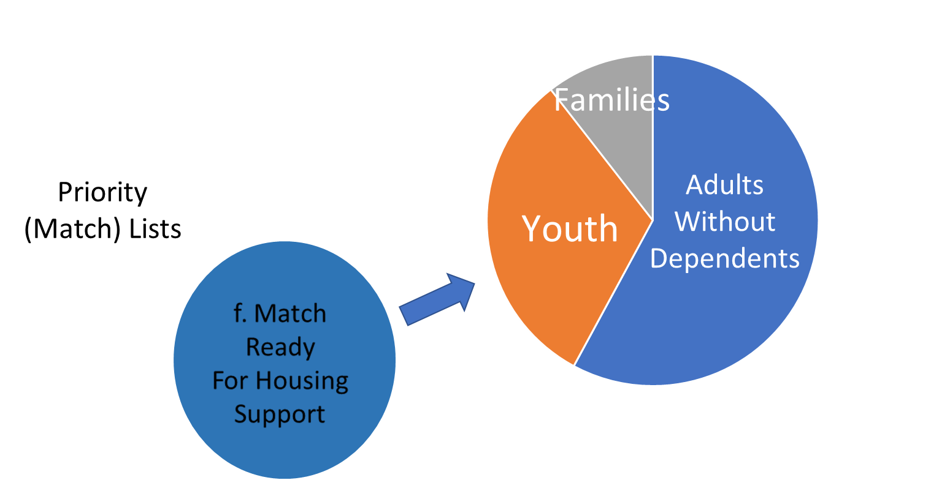
Priority List(s)
Example of further filtering of list by different population groups – each community will do so in the ways that make the most sense for them
Notes:
Can think of c) as the entire universe of people experiencing homelessness that is known and consent to be on the list or in your database – continue to reach out to those unknown and not currently interested in sharing their information to ensure By-Name List is as complete as possible.

Slide 15
Where Does BNL Fit in 20KHomes? All The Way!
Key Milestones Toward Sustainable ZERO!
Identify People - Take Action – House the Most Vulnerable
Phase 2
Housing move-ins and monthly reporting
Phase 1
Kick off to a By-Name List
Phase 3
Quality By-Name
List and monthly reporting
Phase 4
Drive monthly reductions in your actively homeless number
Phase 5
Functional Zero – reach and sustain
Building a By-Name List and Reporting Housing Move-Ins
System Understanding, Improvement, Functional Zero

Slide 16
Monthly Data Reporting
Start by tracking monthly housing move ins. As Canadian communities build a real-time, by-name list, you’ll track and respond to a more dynamic picture of your full systems
INFLOW
ACTIVELY HOMELESS
OUTFLOW
You’ll start by tracking housing move-ins and work your way up!
Monthly data reporting
INFLOW:
NEWLY
IDENTIFIED
INFLOW:
RETURNED FROM HOUSING
INFLOW:
RETURNED FROM INACTIVE
OUTFLOW:
HOUSING MOVE-INS
OUTFLOW:
MOVED TO INACTIVE
Notes:
So you will eventually be including all of these measures in your monthly reporting. The place that communities generally start is with housing move-ins. As you build your By-Name List, you will begin to report on the three inflow measures of newly identified, returned from housing and returned from inactive. With this inflow and outflow information, you can also report the number of people who are actively homeless on your By-Name List.

Slide 17
Characteristics of a Quality By-Name List

Slide 18
Balanced Data vs. Unbalanced Data
 | ACTIVELY HOMELESS | PLACEMENTS | MOVED TO INACTIVE | NEWLY IDENTIFIED INFLOW | RETURNED TO ACTIVE FROM HOUSING | RETURNED TO ACTIVE FROM INACTIVE | NET MONTHLY CHANGE | BALANCE CHECK
Feb 2017 | 200 | 35 | 5 | 30 | 4 | 1 | -5 | Yes
Jan 2017 | 205
205 - ( 35 + 5 ) + ( 30 + 4 + 1 ) = 200
Active Homeless in JANUARY
︸
︸
Active Homeless in FEBRUARY
MONTHLY OUTFLOW
MONTHLY INFLOW
 | ACTIVELY HOMELESS | PLACEMENTS | MOVED TO INACTIVE | NEWLY IDENTIFIED INFLOW | RETURNED TO ACTIVE FROM HOUSING | RETURNED TO ACTIVE FROM INACTIVE | NET MONTHLY CHANGE | BALANCE CHECK
Feb 2017 | 200 | 35 | 5 | 30 | 4 | 1 | -5 | NO
Jan 2017 | 210
210 - ( 35 + 5 ) + ( 30 + 4 + 1 ) 200
Active Homeless in JANUARY
︸
︸
Active Homeless in FEBRUARY
MONTHLY OUTFLOW
MONTHLY INFLOW
Notes:
Also want to just introduce this concept of balanced data – so that when we talk about it in the future you have heard about it and know where we are heading.
Walk through…

Slide 19
10 STEPS to Develop and Use a BNL
20,000 homes campaign
Learn about a BNL
Clarify your scope and build community will
Pick a database and common assessment tool
Complete a Registry Week or build on your CAS
Input and review Registry Week data
Create policies and processes to manage BNL
Identify housing support resources – start housing
Take the BNL Quality Improvement Scorecard
Continue to improve your BNL
Use your BNL data

Slide 20
#1 – Learn About a BNL
20,000 homes campaign
www.20KHomes.ca

Slide 21
System Dynamics
# permanently housed
MONTHLY OUTFLOW
# moved to inactive
# newly identified
MONTHLY INFLOW
150
# returning from inactive
75
0
September 2016 | October 2016 | November 2016 | December 2016 | January 2017 | February 2017 | March 2017
Notes:
Chicago

Slide 22
Counting Down
Current 6-month average housing rate
# actively homeless on By-Name List
Estimated path to functional zero
if average monthly reduction remains the same
1000
750
500
250
0
Functional.
Zero.
January 2016 | July 2016 | January 2017 | July 2017 | January 2018 | July 2018 | January 2019

Slide 23
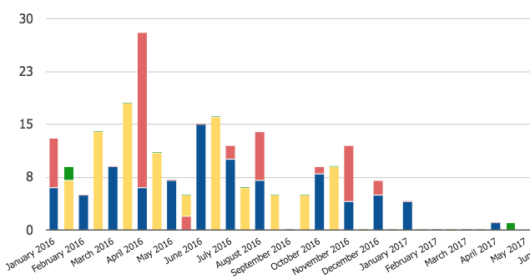
Rockford, IL

Slide 25
Common Questions
What about privacy and consent?
Is HIFIS (or an HMIS) the same thing as a BNL?
Isn’t this just a giant waitlist?
Isn’t it unethical/set up expectations we can’t fulfill if we can’t serve everyone from the list right away?
Is it necessary to have a By-Name List? Isn’t there another way?
20,000 homes campaign

Slide 26
20,000 homes campaign
Notes:
Your questions

