Slide 1
Survey Data – After the Count Learnings from Toronto’s Street Needs Assessments
Laural Raine
HPS PiT Count Training
Toronto
Module 2 – Data Input and Management

Slide 2
Background
Street Needs Assessment has been held three times – 2006, 2009, 2013
Held once per term of Council (every 4 years) in April
Survey of all emergency shelters, VAW shelters, health and correctional facilities
Estimate of outdoor population based on survey of 50% of City’s geography
1,981 surveys completed
Estimated 5,253 people who were homeless

Slide 3
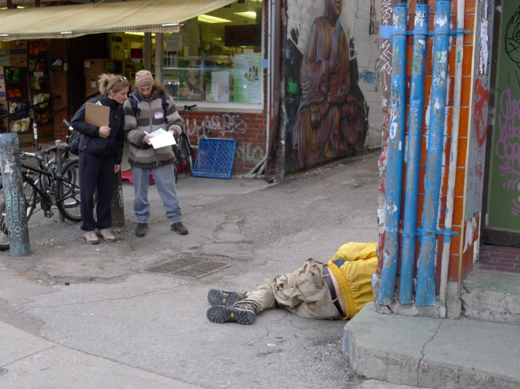
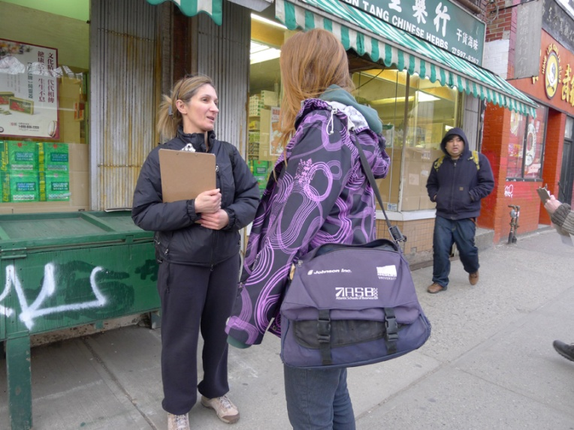
Survey Design
Tested survey instrument in advance to ensure clarity for volunteers and clients
Manually recorded survey responses
(i.e. pen and paper)
Survey scanning software
Weigh the potential time savings against the financial cost and resource (time) cost

Slide 4
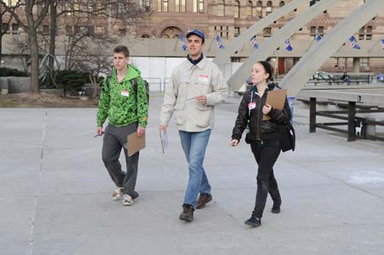
Data collection – Survey Teams
Each survey team receives a package with survey templates
Volunteers record the study area identifier on each survey
Team Leader secures each survey after completion
Completed surveys are returned to the Field Office

Slide 5
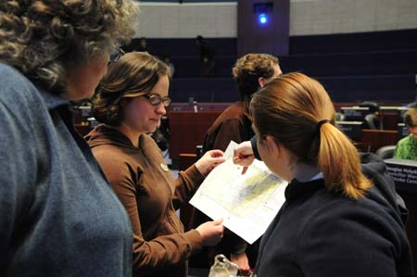
Data Collection – Field Offices
Field Office staff ensures all surveys have a location recorded
Secure them in a sealed envelope with number of surveys recorded on outside
Tracking sheet to verify all study areas returned an envelope (even ‘0’s)

Slide 6
Data Collection – Survey Reception Office
Survey Reception Office ensures all field office return a box of sealed envelopes that night – verifies against tracking sheet
Next day, Survey Collection Officer transfers all boxes of surveys to centralized secure storage location for analysis
For partner locations, surveys are secured in sealed envelopes and picked up or couriered the next day
Notes:
The Field Office box with all envelopes is sealed and delivered to Survey Reception Office that night.

Slide 7
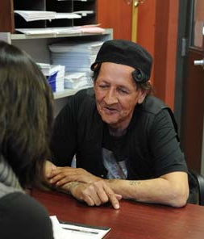
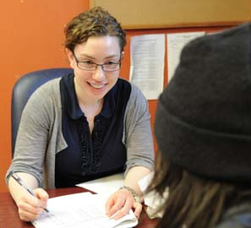
Survey Analysis
Assemble a small team responsible for coordinating data input and survey analysis
Count all surveys in envelopes to ensure count matches total on envelope
Record a unique identifier on the front of each survey
Scan all surveys electronically and compile data into database

Slide 8
Quality Assurance
Survey validity review
Review surveys for location slept last night to ensure validity
Observed homelessness – independently reviewed by 2 people to deem eligible or not for inclusion
Once data has been entered, selected random sample of 10% of surveys
Compare against scanned survey using unique identifier
Error rate of greater than 10% in any one question, review all surveys for that question
Notes:
Once surveys are scanned in, select a random sample of 10% of surveys. Conduct QA test to ensure data accuracy by comparing the scanned image against the inputted data for all surveys in the 10% sample (double click on the survey to open the image. Go to View>Data Mode to see data and image side by side).
If any particular question has an error rate of more than 10% in the sample, manually check that question in all surveys.
Look for:
identify suspect entries
people who have answered the survey twice

Slide 9
Quantitative Results
Collect count figures using administrative systems
Shelter count
Admissions from Shelter Management Information System (SMIS)
VAW sector
total occupied beds provided by MCSS
Health and Treatment facilities
use their patient records to identify how many of their patients had no fixed address (NFA) on admission
MCSCS provides data from the central data processing centre
Includes everyone from a Toronto court who had an address that was NFA or a shelter address.
Notes:
Collect count figures using administrative systems
The total number of individuals at each shelter with an admission that resulted in a bednight is provided from SMIS.
MCSS provides a breakdown of the number of total available VAW beds at each location and the number occupied.
Health and Treatment facilities are asked to use their patient records to identify how many of their patients had no fixed address (NFA) on admission.
data on the total number of individuals who are homeless is provided by the central data processing centre for MCSCS.
A list of all shelter addresses is provided to them in advance. They then generate a list of everyone from a Toronto court who had an address that was NFA or a shelter address.

Slide 10
Data Security
Survey data stored on a secure server, with access limited to core group inputting data
Stored paper forms in a secure location (locked cabinet)
Keep paper copies until analysis is complete, in case electronic records need to be verified
Once no longer needed, should be shredded

Slide 11
Analysis of policy implications
Partner with external experts for independent review of methodology and result
Assemble a group of key stakeholders to review survey findings in advance
Identify key themes from findings and policy implications
Gather intelligence on possible explanations for trends to inform report

Slide 12
Reporting results
Develop communications strategy in advance
Some key information can be communicated directly following
E.g # of volunteers, # of study areas covered
Interim report (July)
Estimate of # of homeless plus key findings from the survey
Full report to Council (September)
Complete findings and policy implications

Slide 13
Questions?
Contact info:
Laural Raine,
Manager Strategic Policy and Service Planning
Shelter, Support and Housing Administration
City of Toronto
416-392-0546
lraine@toronto.ca

