Slide 1
After the Count: Data Entry and Cleaning
Christina Maes Nino, Community Animator, Social Planning Council of Winnipeg
Module 2 ─ Data Input and Management

Slide 2
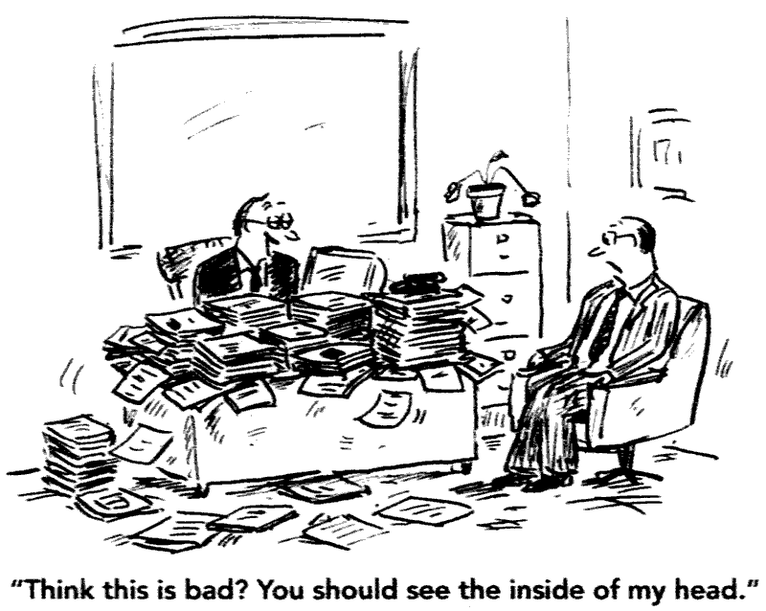
Post Count Activities
Notes:
Depending on your methodology, after the count you’ll likely feel a little scattered. We had boxes of supplies and surveys at various organizations, random packs of cigarettes and surveys being returned from PACT and outreach teams, etc. Being organized in your planning will make a big difference

Slide 3
Post Count Activities
These are actually PRE Count:
Write EVERYTHING down, ideally in the same place
Have a plan and a deadline for data entry and analysis
DURING the count:
Keep the surveys organized at the base sites
Keep track of all the shelter data locations and send reminders to people who will fill them in
Keep track of everyone who may have surveys in other locations and send reminders to collect them

Slide 4
Post Count Activities
We:
Kept surveys in envelopes organized by volunteer
Went through each volunteer survey, looked for obvious issues
Made a plan to deal with surprise survey issues
Notes:
Because we assume errors, missing information and other data issues will be tied to the person conducing the survey
Missing information (location, time, name of volunteer), incomplete or just plain weird surveys and marked them so volunteers are not entering data from them
(sheltered vs. unsheltered survey)

Slide 5
Entering Data
We:
Tested data entry in advance
Held a training session with all data entry volunteers
Marked everything data entry volunteers changed, added, or data that stood out as a likely error
Only had 4 volunteers with attention to detail and a lot of time for data entry

Slide 6
Entering Data
Other tips for data entry?

Slide 7
Objectives of Data Cleaning
Eliminate (or reduce) duplicates
Eliminate (or reduce) errors in data entry and data collection
Increase validity/ reliability of analysis
Any others?
Notes:
Results can vary significantly if you have incorrect data
For instance, if someone entered a date wrong, it can introduce outliers which then bias the average of a variable. (i.e. someone entered 999 years for a respondent accidentally, the average age of respondents is going to be overestimated)

Slide 8
Reducing Duplicates
Use identifying information to check for duplicates
For Winnipeg Street Census
DOB/Aboriginal Status/Gender

Slide 9
Reviewing Possible Errors
Conduct frequency analysis for EVERY variable in your dataset
Logic Checks… are responses logical? Was the age of the respondent 120 years old? Did a person self-describe as male also report being pregnant?
Review:
Mean, median, mode, standard deviation, skewness, kurtosis, range (MINIMUM AND MAXIMUM VALUES)
Notes:
-check for responses that seem illogical while entering data and mark it

Slide 10
Reviewing Possible Errors
By requesting a graphic (bar chart/scatterplots/ histogram) for each variable you can catch problems visually
Real outliers vs. coding errors
This will allow you to identify coding errors by variable and begin to correct them

Slide 11
Increase Validity/Reliability of Analysis: Code “Other” Responses
Example:
Q: What is the reason you first became homeless?
A: Mom died; children passed away; parents’ death;
Read through all the responses to see if they belong to an existing category
Create new categories if a certain answer is repeated often
New category for “death in family”
If the “Other” category large, (12-20%) then consider developing new categories– otherwise bivariate analysis might lose meaning

Slide 12
Increase Validity/Reliability of Analysis: Deal with Missing Responses
If it doesn’t make logical sense, doesn’t seem valid, mark it as missing
Check that all the symbolic data (eg. 01 where the month was missing) is entered consistently
Note fields where there is a lot of missing data so it is not used in analysis incorrectly

Slide 13
Increase Validity/Reliability of Analysis: Deal with Missing Responses
Key questions to check:
How old were you when you first became homeless?
When did you become homeless most recently?
How many times have you been homeless in the past three years?
How long have you been homeless throughout your lifetime?

Slide 14
Reviewing Possible Errors, Checking Reliability/Validity
Other ways to check for errors?

Slide 15
Things I’ve found helpful: - If you don’t know, ask - Use resources in the community (academics, health authority staff) as well as people from other communities - Be realistic about the limitations of your data
Notes:
A count coordinator has to wear many hats, if something isn’t your area of expertise, don’t try to do it yourself. A point-in-time methodology has limitations, recognize them. It doesn’t mean what you do find out is not valuable.

