Slide 1
Reaching Home Community Homelessness Report (CHR)
Community Entities’ Webcast
November/December 2020

Slide 2
Learning Goals
At the end of this training, you will be able to:
Explain the CHR;
Describe the CHR lifecycle and roles within it; and,
Identify resources available to support you.

Slide 3
Training Outline
Introduce the CHR (who, when, what, why)
CHR Sections (how)
CHR Reporting Tools (how)
Roles, responsibilities and timelines (how)
Next steps

Slide 4
1. Introduce the CHR

Slide 5
Who Completes the CHR and When?
All communities receiving funding from the Designated Communities (outside Quebec) and Territorial Homelessness streams are required to complete a CHR.
For these communities, completing the CHR each year is a minimum requirement.
The first CHR is due to Service Canada by June 30, 2021 and will cover the first two years of the program.
Note: The CHR does not replace annual results reporting (Results Reporting Online or RROL).

Slide 6
What is the CHR?
Self-assessment tool for Coordinated Access and use of HIFIS (or existing, equivalent system) minimum requirements.
Steps for generating a comprehensive unique identifier list.
Reporting tool for annualized, community-level data.
Gives year-over-year picture of the state of homelessness at the community level and the system in place to address it.
Data focuses on:
Cumulative levels of homelessness;
Inflows into and outflows from homelessness; and,
Progress with meeting targets in five core outcomes.

Slide 7
Under Reaching Home, communities work toward five core, community-level outcomes.
REDUCTIONS in…
Indigenous homelessness
New inflows to homelessness
Returns to homelessness
Chronic homelessness
Overall homelessness

Slide 8
2. CHR Sections

Slide 9
Section 1: Community Context
Opportunity to share information about:
their local context;
impact of COVID-19; and,
level of engagement and collaboration between Indigenous and non-Indigenous organizations.
Mostly open comment boxes, some Yes/No options.
CEs may be required to follow-up on their answers in
a future Mid-Year Dialogue or other process.

Slide 10
Section 2: Self-Assessment
CEs self-assess their work to meet the Coordinated Access and HMIS minimum requirements using a checklist of “actionable items” based on the Reaching Directives.
Provides guidance for putting the necessary human resources and technical infrastructure in place; builds on the Reaching Home Coordinated Access Guide.
Response options mostly Yes/Under development/Not yet started, some comment boxes

Slide 11
Self-Assessment (cont.)

Slide 12
Section 3: Community-Level Data
Unique identifier lists (Lists) make it possible to measure, monitor and share progress with the Reaching Home outcomes.
Section 3 provides guidance on generating data from a List:
Step 1: Does the community have one?
Step 2: What kind of data can be generated from it, currently?
Step 3: Report some data!
Communities complete Section 3 regardless of how
comprehensive their List is, currently. They can work to increase
the quality and comprehensiveness of their data over time.

Slide 13
Community-Level Data (cont.)
1
2
3
Cumulative levels of homelessness
Inflows into homelessness
Outflows from homelessness
Total + Just Chronic Homelessness + Just Indigenous Peoples

Slide 14
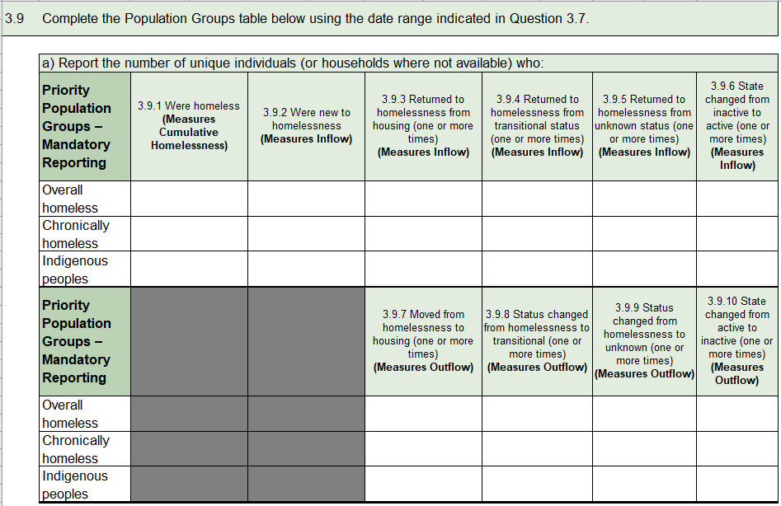
Community-Level Data (cont.)

Slide 15
Section 4: Community-Level Outcomes
Section 4 provides guidance on generating outcome data and tracking progress with reduction targets over time.
A comprehensive list includes all individuals and families experiencing homelessness in the community, as much as possible. People will have come into contact with the system in some way and provided their consent.
Communities only complete Section 4 if they:
Have a comprehensive unique identifier list; and,
Have a full year of data.

Slide 16
Community-Level Outcomes (cont.)
Step 1. Confirm comprehensiveness of the unique identifier list based on current standards; only communities that believe everyone experiencing homelessness is included in their data move to Step 2.
Step 2. Confirm that the unique identifier list has been in place for at least one year, which is the minimum requirement for the CHR.
Step 3. Report outcomes and set reduction targets for:
Homelessness overall;
First experience of homelessness;
Returns to homelessness;
Indigenous peoples experiencing homelessness; and,
Chronic homelessness (target is 50% reduction by 2027-28).

Slide 17
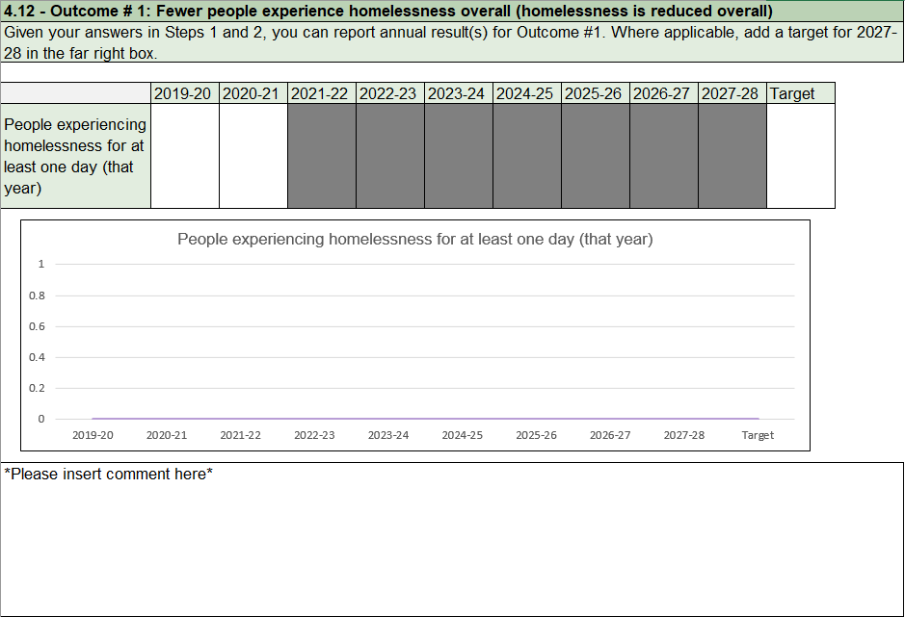
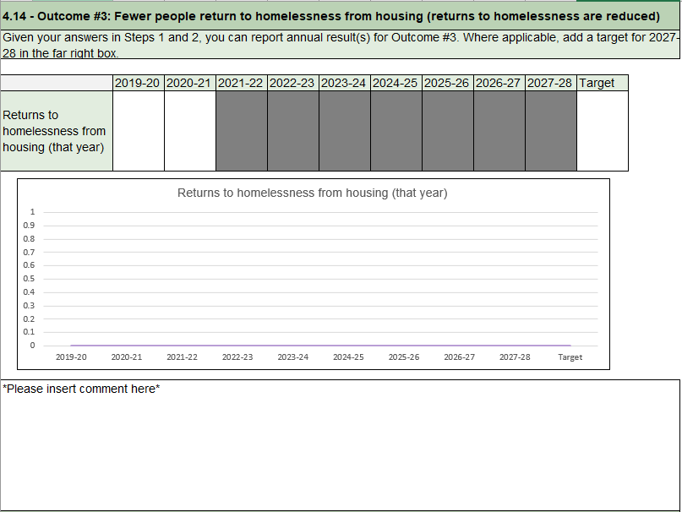
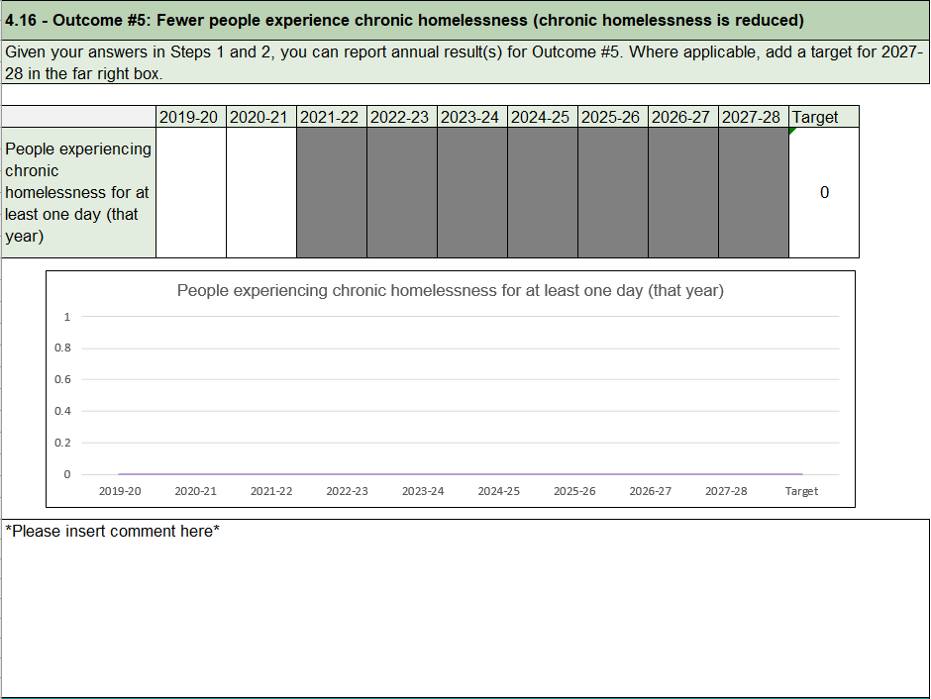
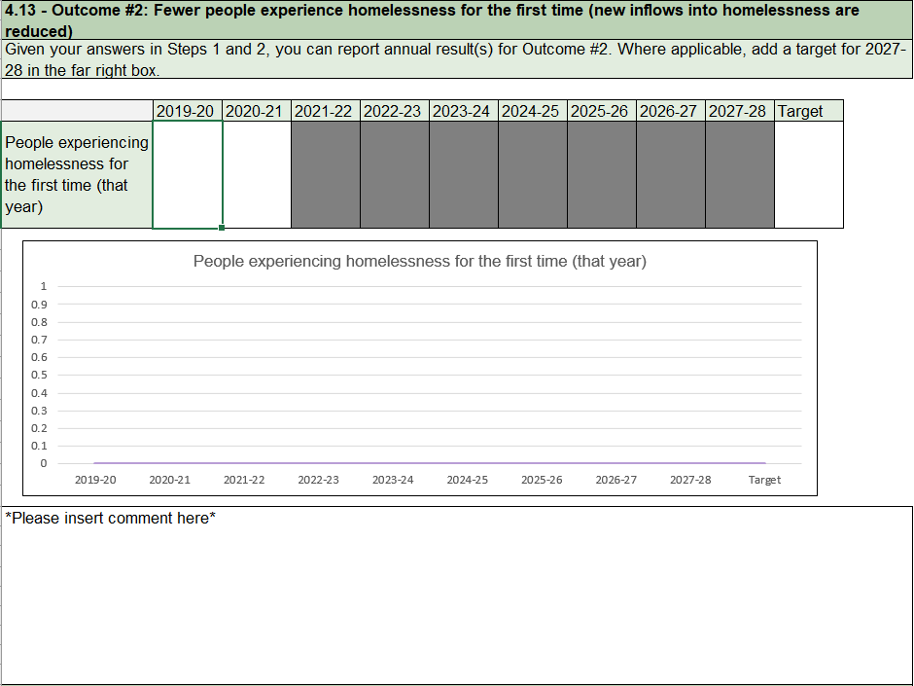
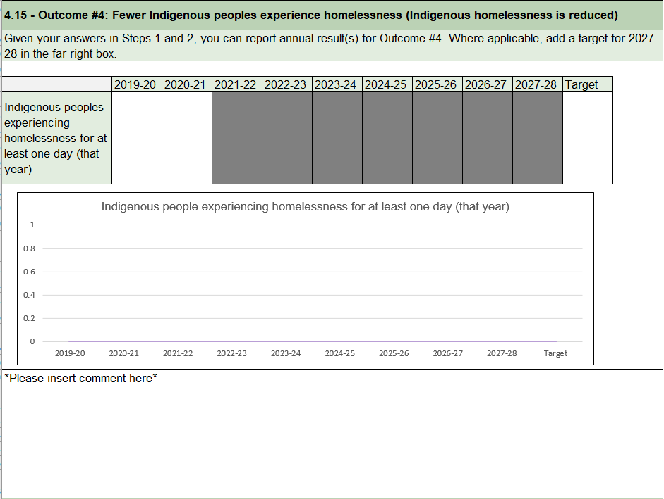
Community-Level Outcomes (cont.)

Slide 18
Let’s Review!
CHR gives a picture of the state of homelessness at the community level. Summaries will be publicly available.
Engagement and collaboration between Indigenous and non-Indigenous organizations is expected.
Work to reach requirements for Coordinated Access and use of HIFIS* is self-assessed.
CHR supports the transition to an outcomes-based approach, includes community-level data and outcomes.
* or existing, equivalent system

Slide 19
What resources can be consulted?
Community Homelessness Report Tools
E-Course on the Hub
Reaching Home: Coordinated Access Guide
HIFIS
Implementation Guide and
Release 59 Tools
CAEH
Training and Technical Assistance/
Built for Zero

Slide 20
3. CHR Reporting Tools

Slide 21
Overview of the CHR
START
Community Context
Self-Assessment
Community-Level Data
Community-Level Outcomes
Four sections with 52 questions.
As the CHR template is filled out, some questions (cells) may “lock”. If this happens, no response is needed for those questions.
CHR Reference Guide:
Orange boxes offer tips to consider
Purple boxes provide question-specific information, mostly for clarity
Green boxes identify terms and concepts with links to other tools
Green summary pages reinforce key messages
1
2
3
4
FINISH

Slide 22
Overview of the CHR Template

Slide 23
4. Roles and Responsibilities

Slide 24
Overview: Roles and Responsibilities
Community Entities
Community Advisory Boards
Service Canada
Homelessness
Policy
Directorate
Attend HPD training.
Ensure engagement and collaboration between Indigenous and non-Indigenous organizations (e.g., DC and IH CEs and CABs, if applicable).
Complete a draft CHR and incorporate feedback on it from CAB(s) and other partners.
Submit an approved CHR to Service Canada.
Make any adjustments as identified by Service Canada (if required).
Publish summary results.
Review the draft CHR and provide feedback to the CE.
Approve the final CHR and sign-off.
Use CHR results to inform discussions on local priorities, challenges and opportunities. Focus on taking action to achieve Reaching Home minimum requirements and outcomes.
Attend HPD training.
Receive the CHR from the CE and complete a first review, using the Review Grid.
If needed, follow-up with the CE on any items.
If no additional follow-ups are required, forward the CHR and Grid to HPD for a second review.
Follow-up with the CE on any items flagged by HPD, if required.
Once the PDF version of the summary is received from HPD, send a copy to the CE and request that it be made available to the public.
Host CHR training.
Receive the CHR with its Review Grid from Service Canada and complete the second review.
Notify Service Canada of any additional follow-ups required from the CE.
If no additional follow-ups are required, secure sign off and create a PDF version of the summary.
Send a PDF of the summary to Service Canada.
Summarize CHR results and support next steps.

Slide 25
5. Next Steps

Slide 26
What’s Next?
Action Item | Timelines
Post CHR reporting tools on Homelessness Learning Hub | Nov 18
Host webinars* for CEs (4 dates to choose from) | Nov 25 to Dec 3
Host webinar* about CHR data (e.g., for HIFIS Leads) | Jan 2021
Release CHR questions webcast* for CEs (detailed instructions) | Jan 2021
Launch CHR Case Study Working Group (optional) | Jan 2021
Host follow-up webinar* for CEs and HIFIS Leads about CHR data | Feb 2021
Release CHR HIFIS Report | Spring 2021
Host webinar* for CEs with CHR Case Study Working Group | Spring 2021
CEs submit CHR to Service Canada | June 30, 2021
* recordings will be added to the e-course on the Homelessness Learning Hub

Slide 27
CHR Milestones
Oct | Nov | Dec | Jan | Feb | Mar | Apr | May | June | July | Aug | Sept | Oct | Nov | Dec
Launch:
Nov 18, 2020
Deadline: June 30, 2021
CHR Lifecycle
Data Collection by CEs (to Mar 31)
Submissions
Publishing by CEs
Reviews and Follow-Ups
MYD 2021
Webinars and Webcasts
CHR
HIFIS Report
CHR Training and Supports
E-course on Hub (as of Nov 18)
Case Study Group
Results Analysis by HPD

Slide 28
Review of Learning Goals
Explain the CHR;
Describe the CHR lifecycle and roles within it; and,
Identify resources available to support you.

Slide 29
Thank you!

